Slide 1
Back to the Viking Age!
Chester and Freya have been thrown back to the Age of the Vikings! But what can they expect to see?
That shouldn’t be there!
It’s time for a game of…

Slide 2
You’re going to see a scene full of pictures. You have to pick the things that shouldn’t exist in the Viking Age.
Good Luck!
(Oh, and don’t get hung up on the specific model/design of things. They’re all just the thing in general.)
Click on the pictures to make them disappear, but if the Vikings had them, they will stay where they are and simply spin.

Slide 3
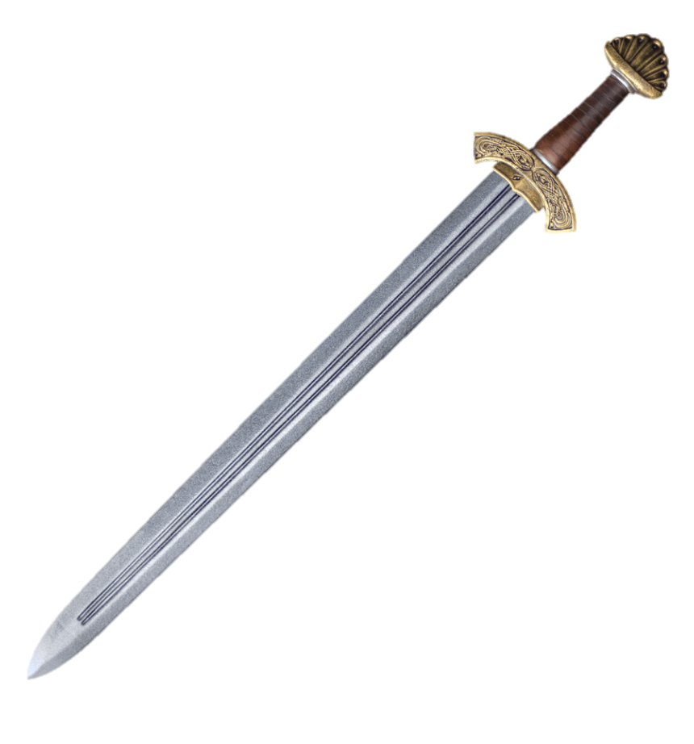
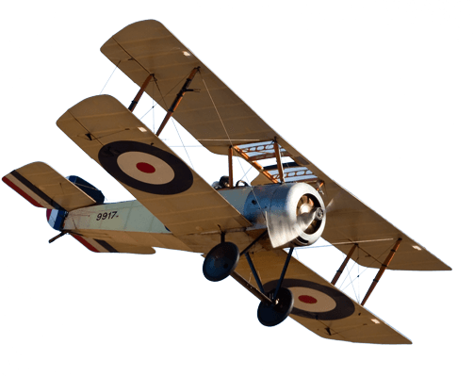
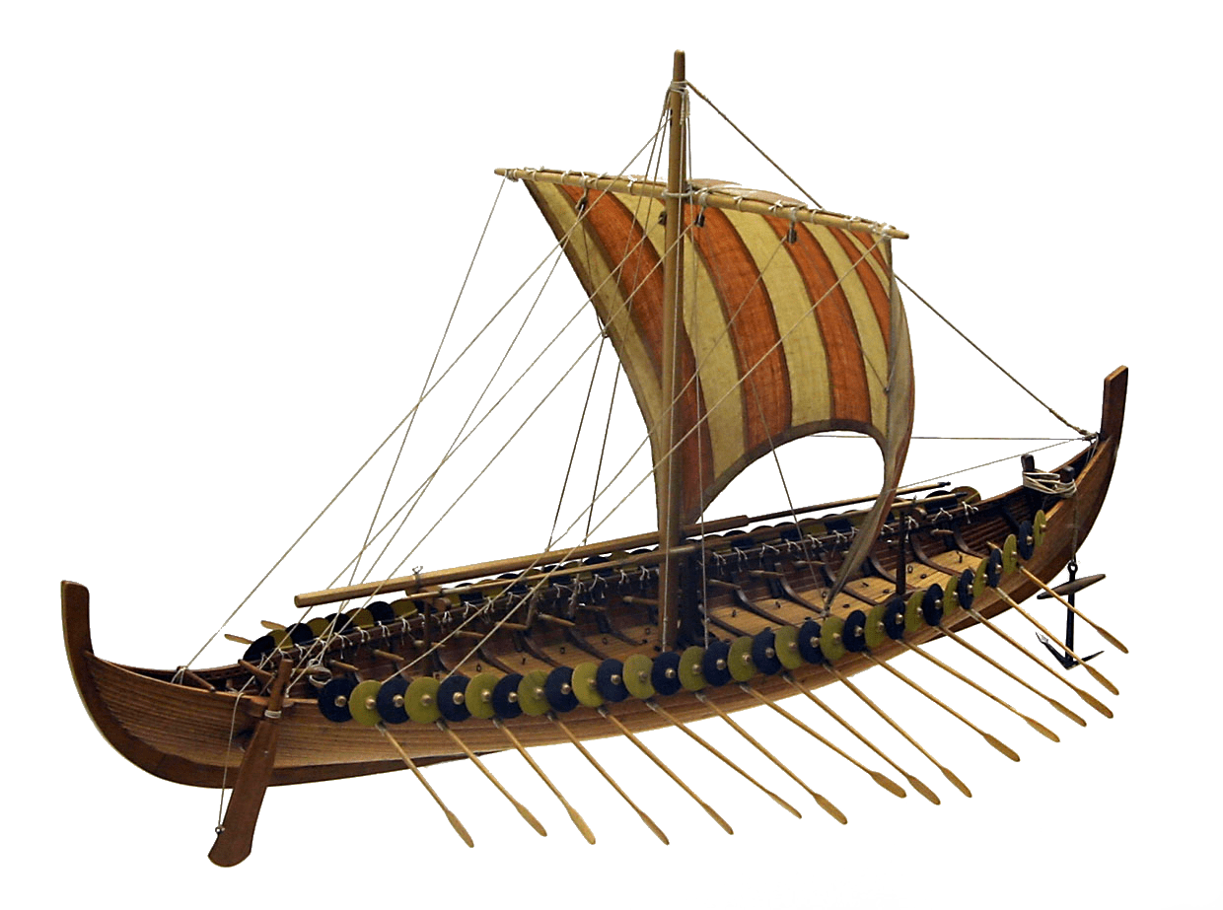
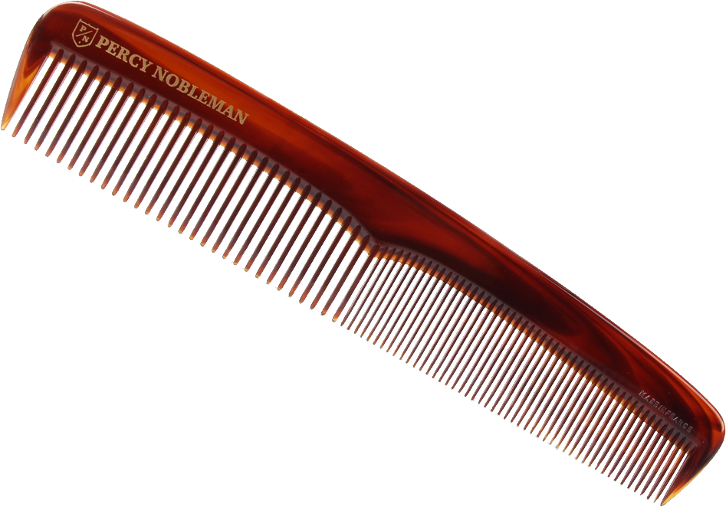
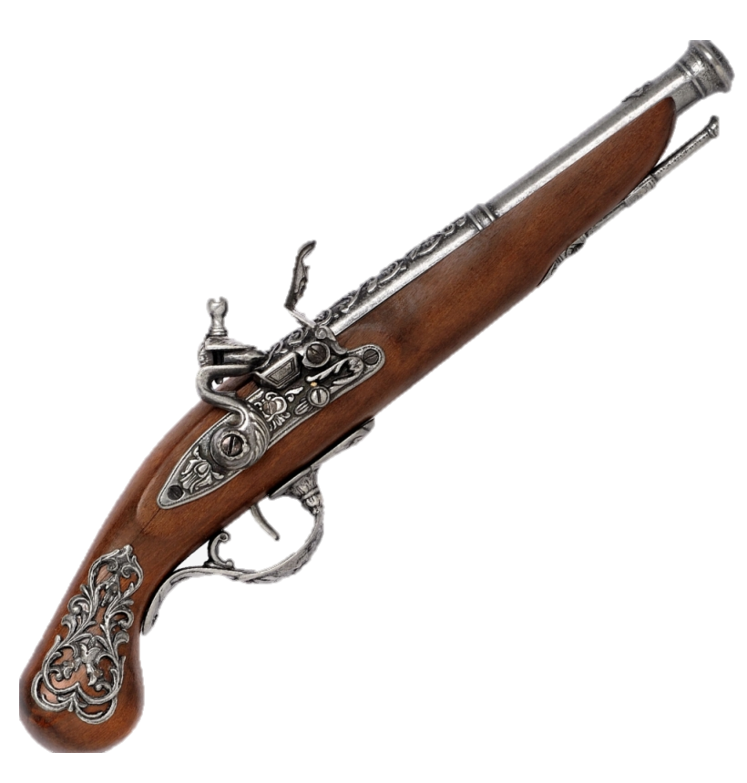
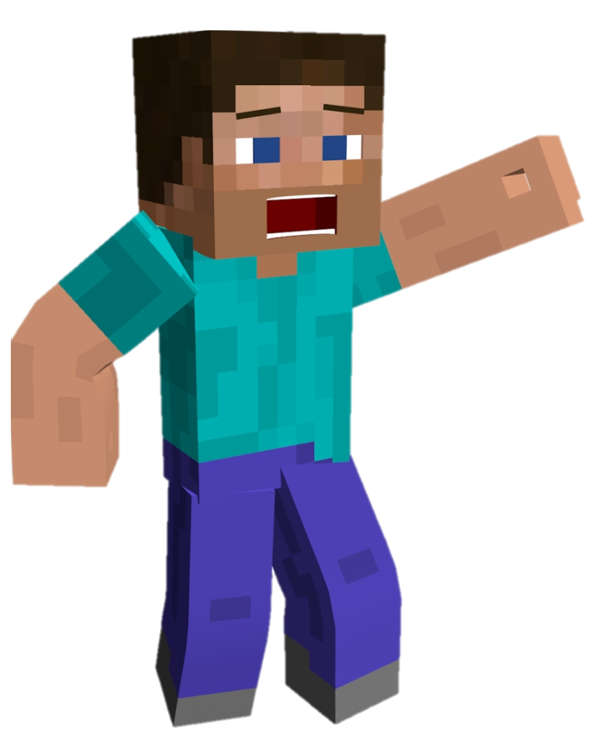
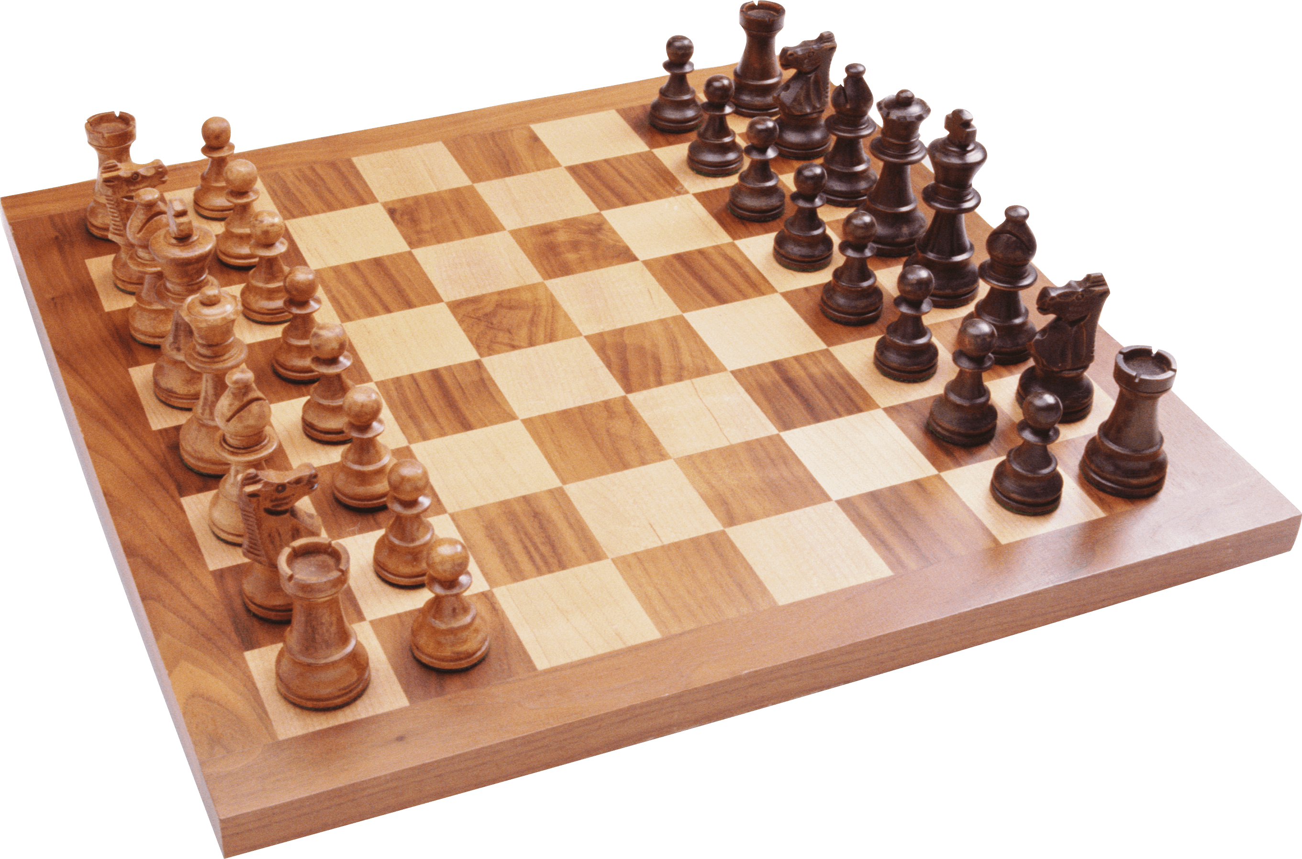
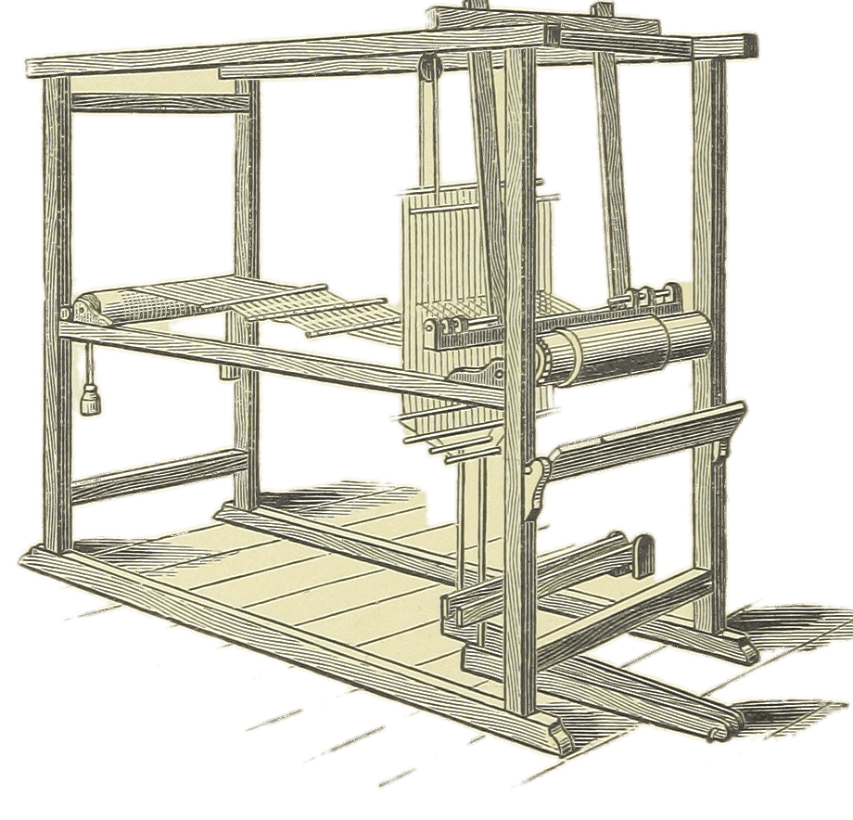
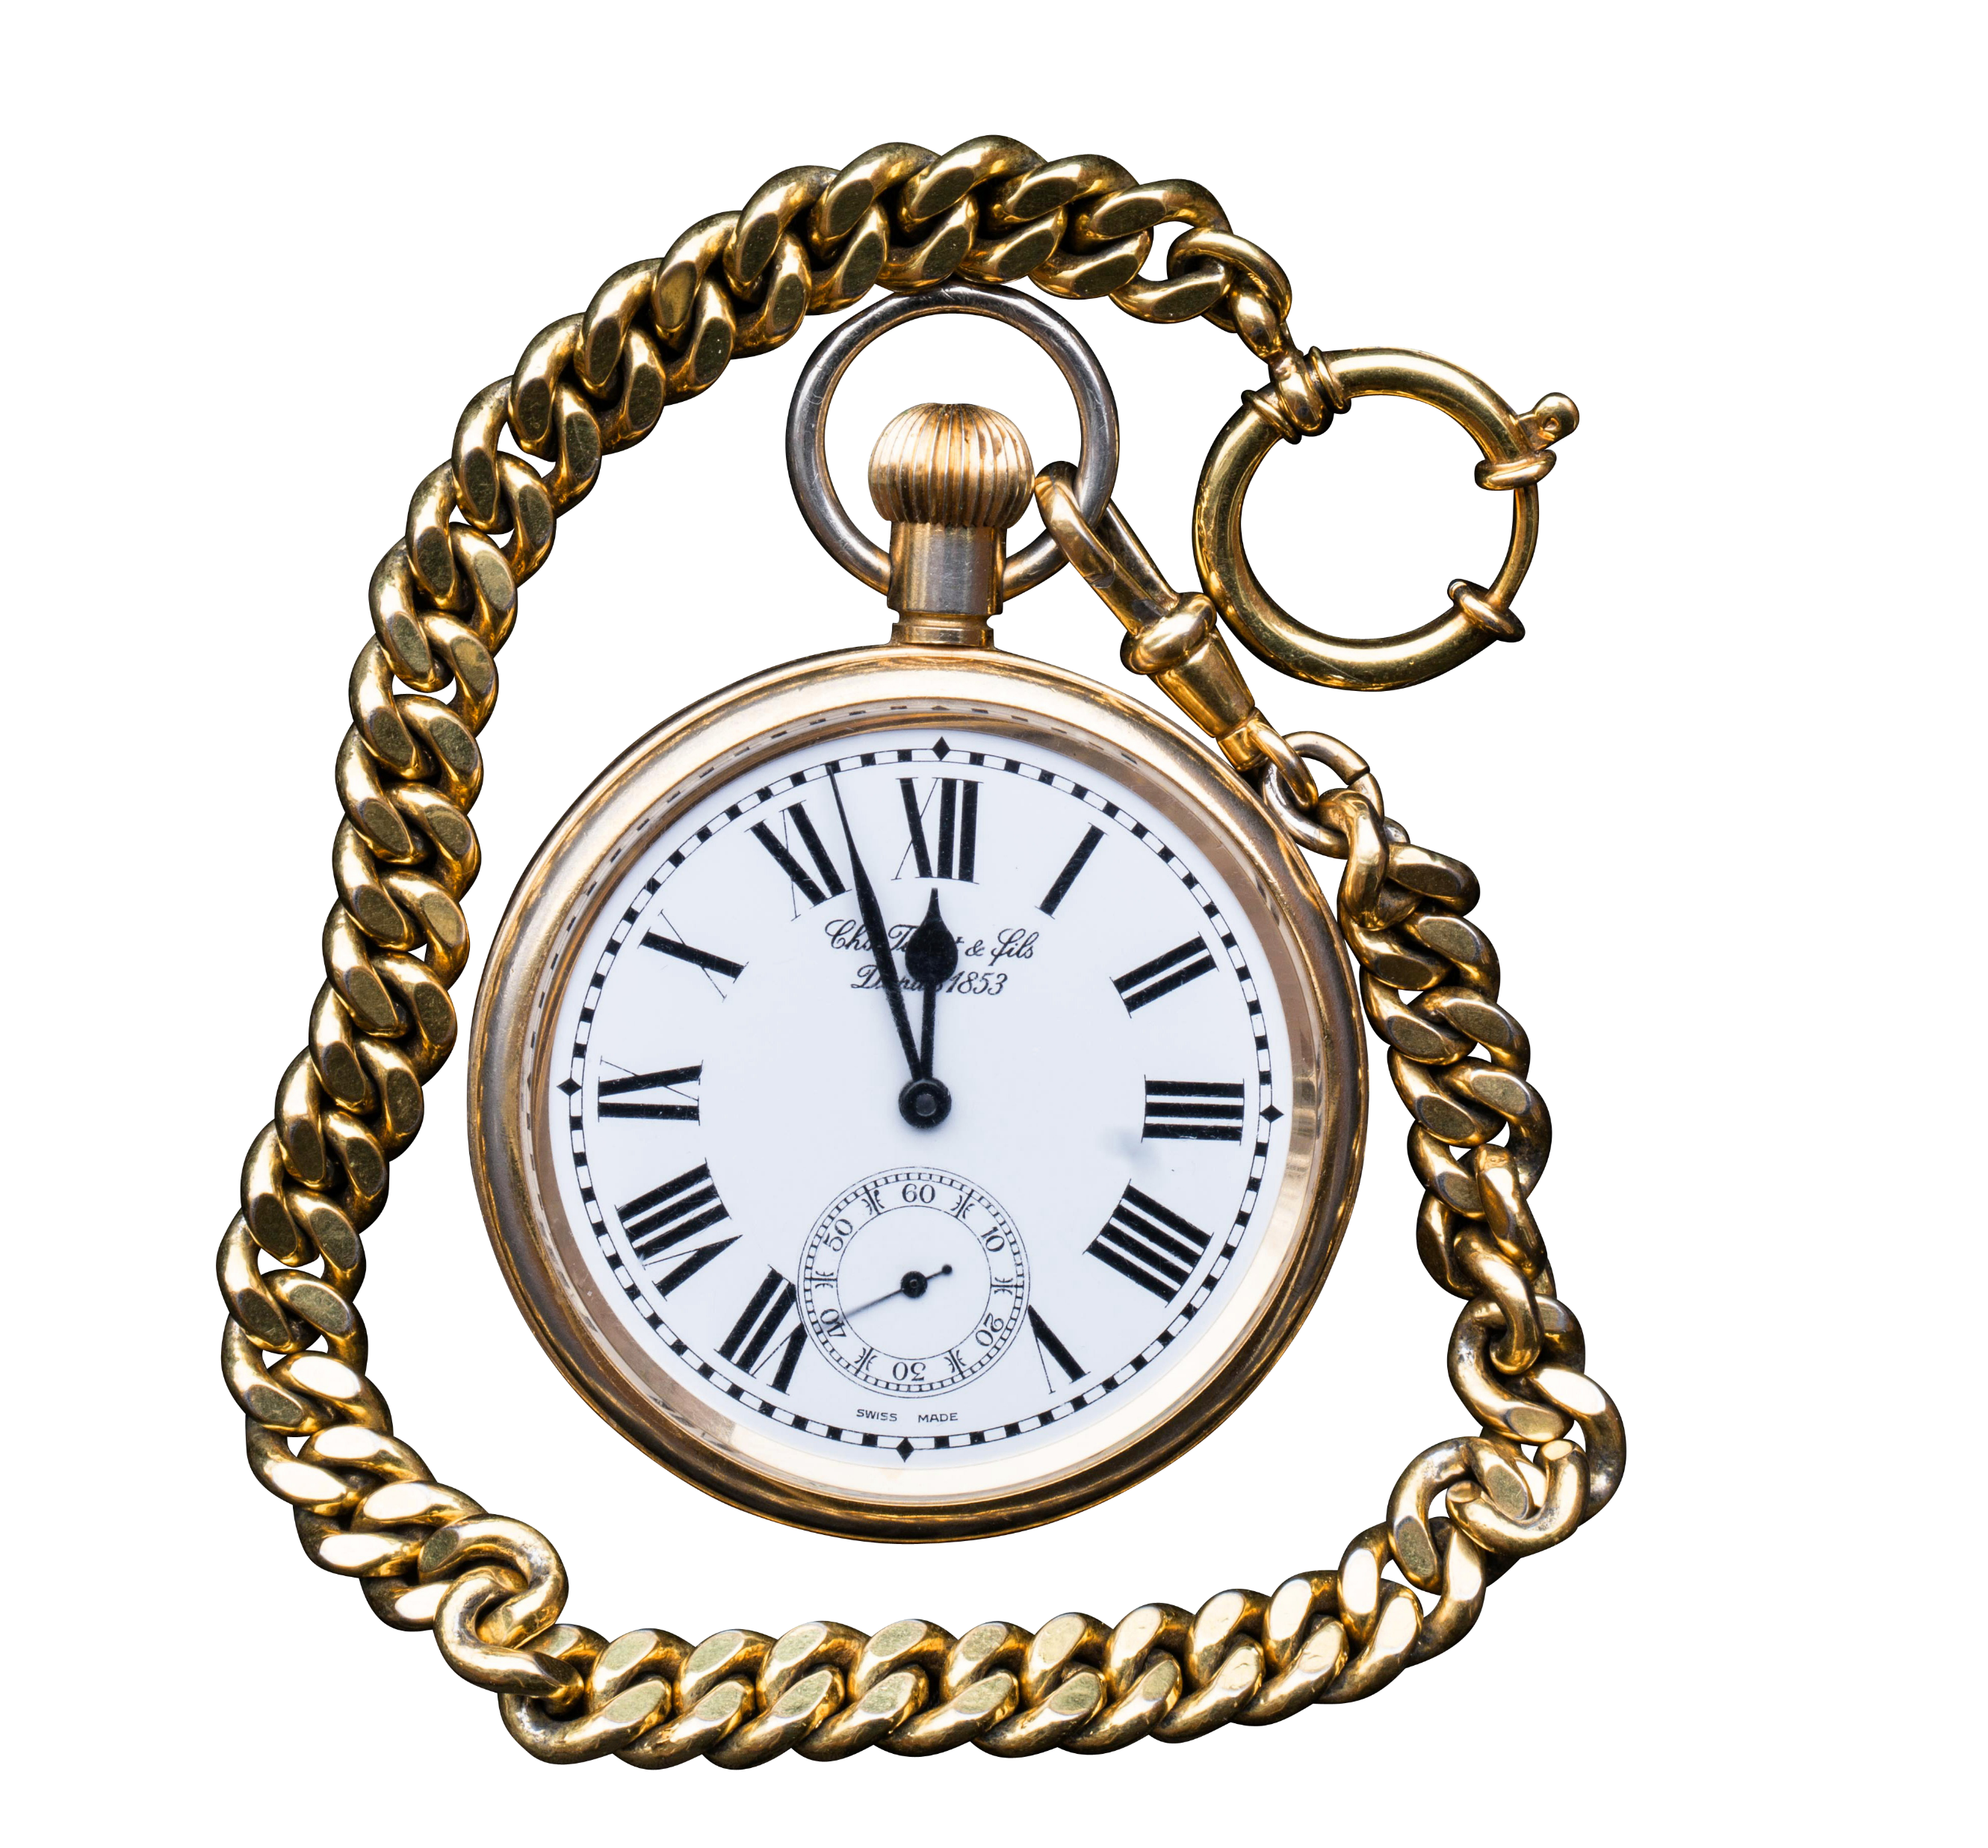
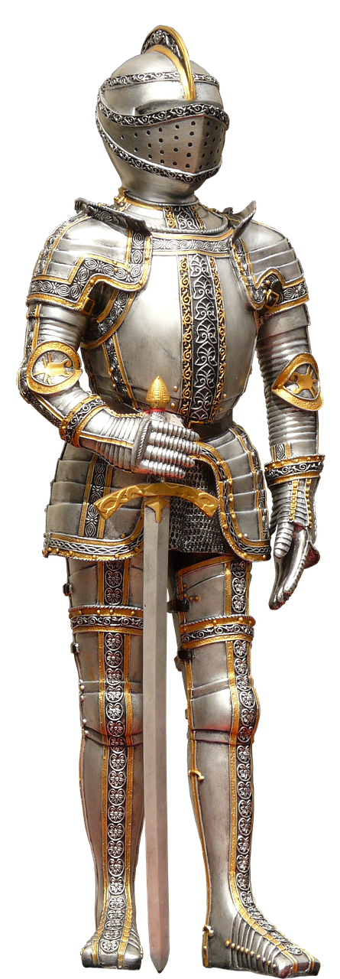
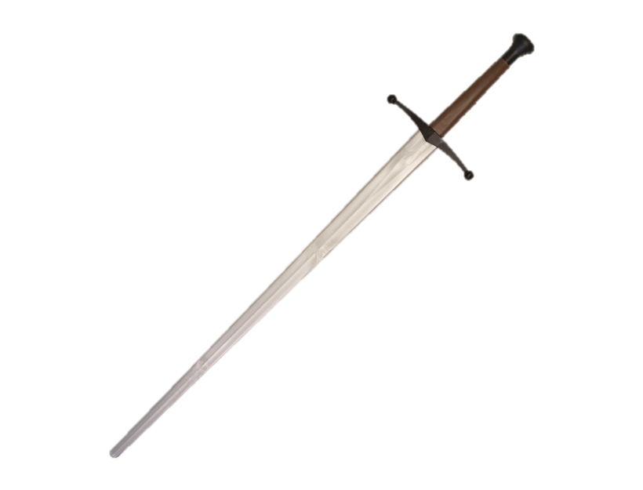
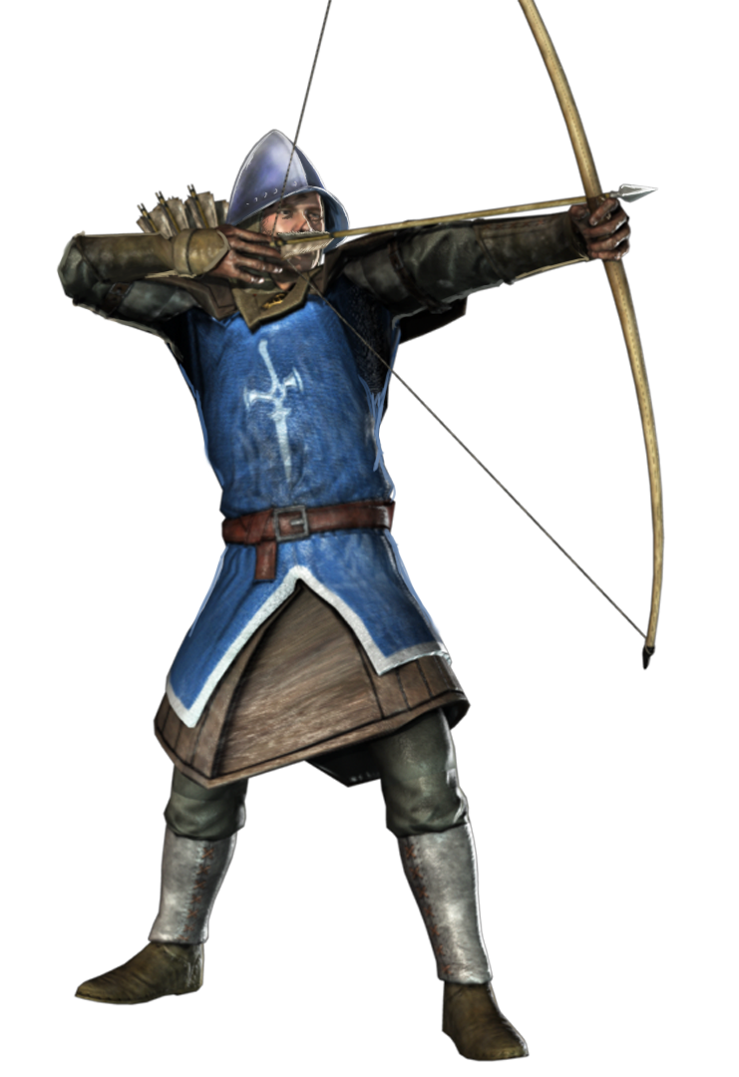
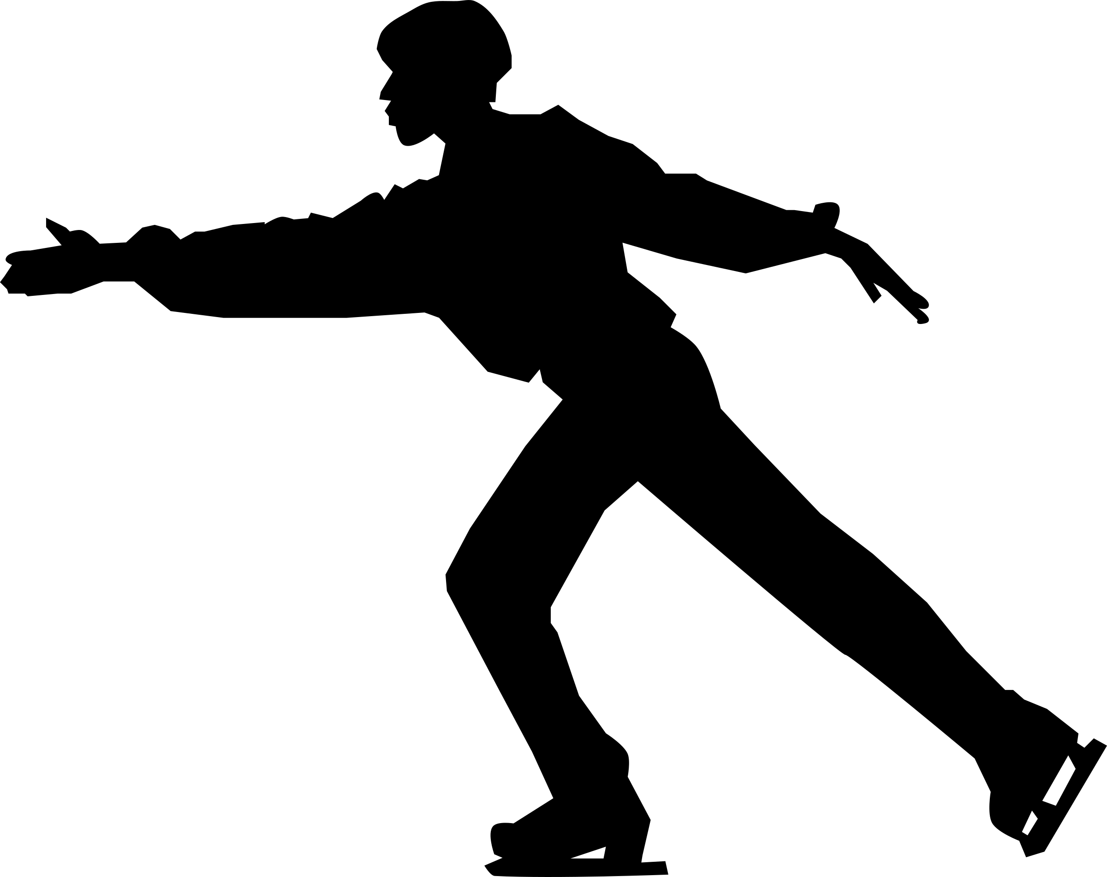
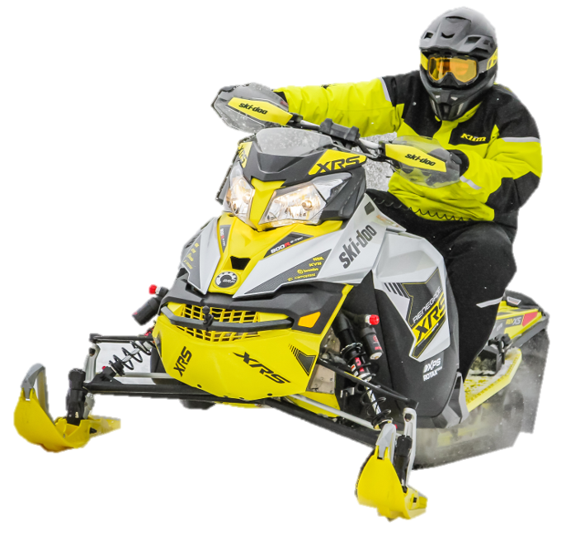
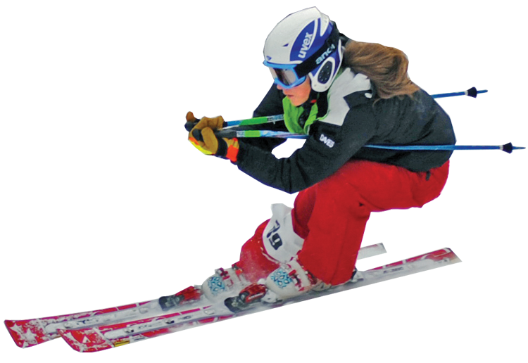
Comb
Padlock
Sword
Plane
Longboat
Gun
Board Game
Video Game
Loom
Pocket Watch
Longsword
Suit of Armour
Skates
Bow
Snowmobile
Skis

Slide 4
Comb
Padlock
Sword
Plane
Longboat
Gun
Board Game
Video Game
Loom
Pocket Watch
Longsword
Suit of Armour
Skates
Bow
Snowmobile
Skis

Slide 5
Viking Age, 793-1066
Along with spears and axes, bows and swords were important weapons for the vikings.
They made their clothes using looms. Kept themselves neat and tidy with their combs, and loved to play board games. Skis, skates and their famous longships helped them get around.

Slide 6
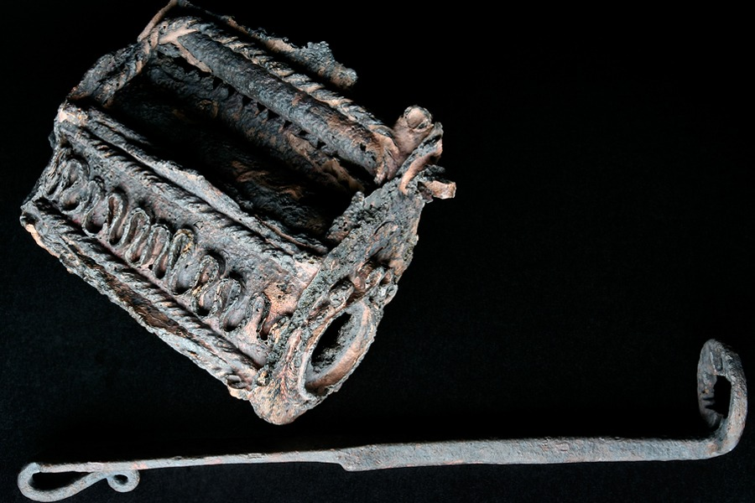
And they were so skilled with tools that they could make intricate things like this padlock.

Slide 7
As for the rest…
First Video Games
Snowmobiles
~1250
First Firearms
~1350
First Aeroplane Flight
~1400
Longswords
~1500
Full Plate Armour
1903
Pocket Watches
1916
1958
Can you guess the dates/order?

Slide 8
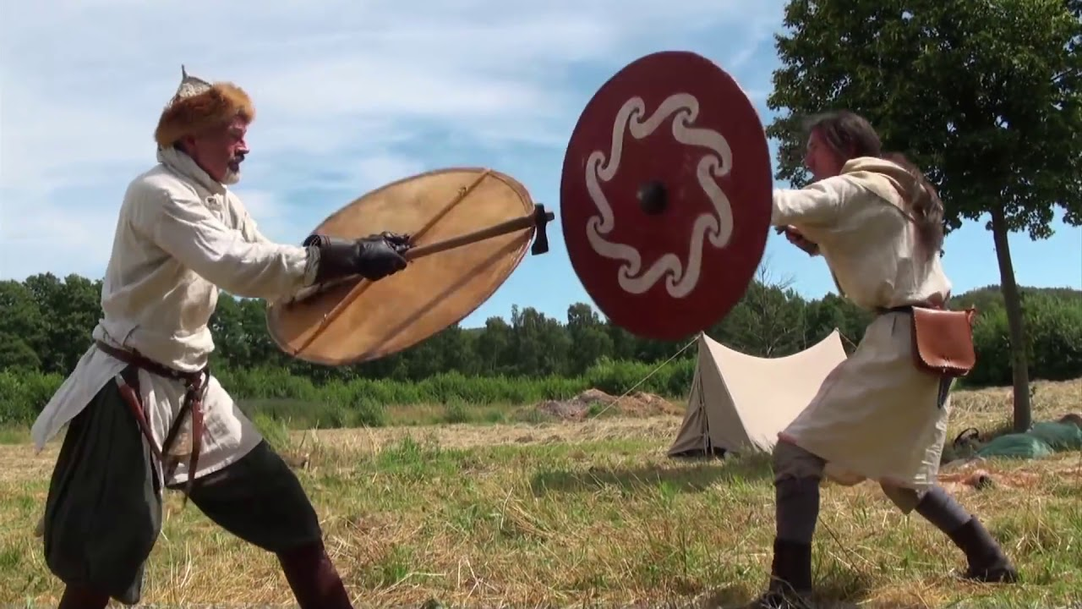
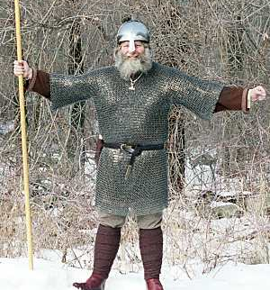
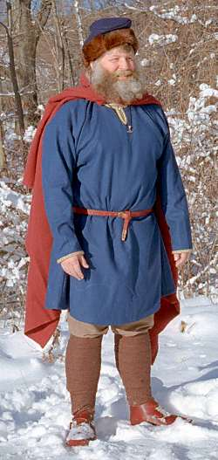
And in case you were wondering…
Longswords were two handed swords. They only became popular when armour was good enough that you didn’t need to carry a shield.
If they wore any, a viking’s armour looked like this:
But usually they dressed more like this:
Either way, they most often fought with a weapon in one hand and shield in the other.

