Slide 1
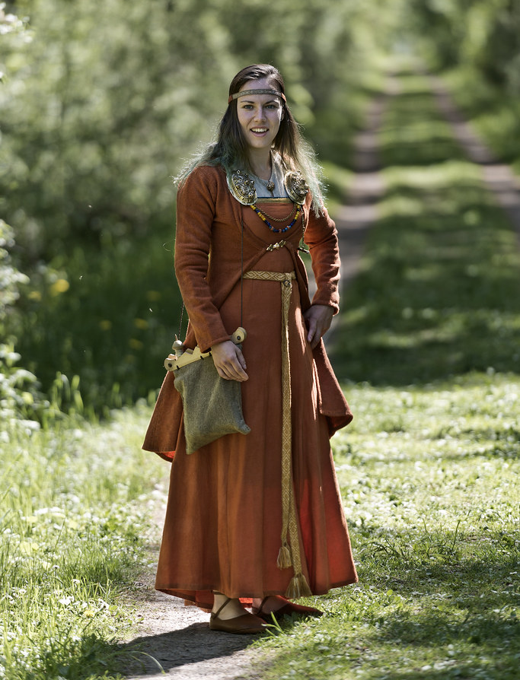
Could Women be vikings?
What is a viking?
Obviously, there were as many women around as men during the Viking Age, but a viking is not just someone who lived at that time. What did it mean to be a viking?

Slide 2
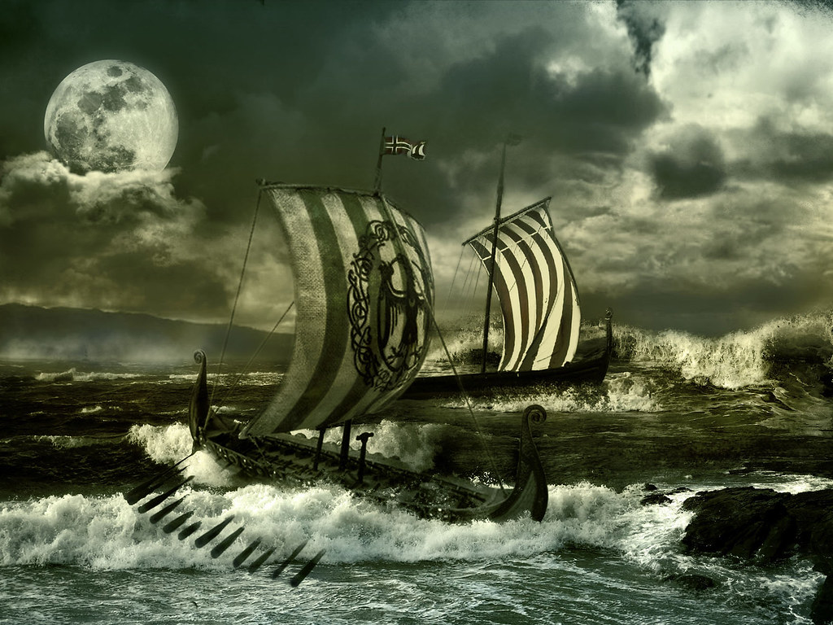
Vikings
Vikingr (viking) literally meant raider or pirate, so picture your stereotypical image of a viking, and you’re not too far off (still no horned helmets, though!)
They were the people who raided towns to steal treasure, people and land.

Slide 3
Could Women be vikings?
So what about female vikings? Did women go out on raids and fight in battle? Or did they look after the home and the farm while the men were away?
Well…it’s complicated.

Slide 4
task
A secondary source is information from someone who has learned it from someone or something else. E.g. a history book.
What is a primary source?
You are a historian. You have been tasked to answer a question about history that no one has properly answered before – say, could women be vikings? The internet and books won’t be much help because no one agrees on what is true? You have to go back to the primary sources. Can you come up with ways to find out how people lived a thousand years ago?
A primary source is information someone or something that was there for the event. E.g. a diary.

Slide 5
How do we know about the past?
Straight away, the vikings give us a problem because they very rarely wrote anything down. We have hardly any Ancient Norse Texts from the time. So we have to rely on:
Accounts from others at the time
Oral History
Archaeology
Artwork
Science

Slide 6
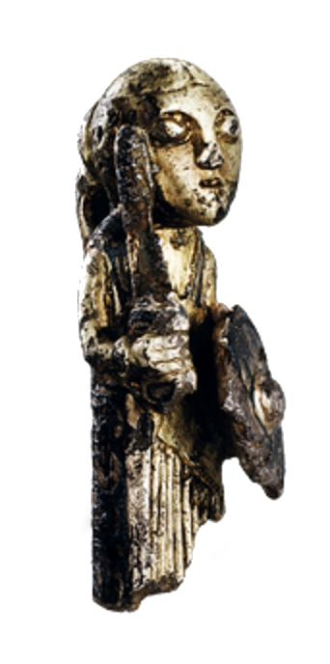
How do we know about the past?
Accounts from others at the time
Vikings didn’t write much down at the time but others did and some of the visited, lived with or fought against the vikings.
Archaeology
Artefacts from the time that we dig up. Grave good are especially useful.
Oral History
Stories passed down through the generation that are eventually written down.
Artwork
Runestones, carvings, models and other art.
Science
Carbon dating, DNA tests etc.

Slide 7
Problems
Accounts from others at the time
(Primary) A lot of these people didn’t like the vikings, so they were biased against them in what they wrote.
Archaeology
(Primary) Who used these things? Why? Can we be sure they are what we think they are?
Oral History
(Secondary) Stories are changed over time. People forget things or just make them up to make the story better.
Artwork
(Primary) Things depicted in art aren’s always real. You can draw anything.
Science
(Primary) Context. Can answer what but not why.

Slide 8
Could Women be vikings?
So, we’ve kept you waiting long enough. Could women be vikings?
The answer is…
…
…
Probably!

Slide 9
Could Women be vikings?
This is new history and people are still debating about it. Did any woman ever pick up a sword and try and steal some treasure? Of course. But how common was it? People still disagree.
There’s new evidence, though, that it was more common than people used to think, and there were probably quite a lot of female vikings.

Slide 10
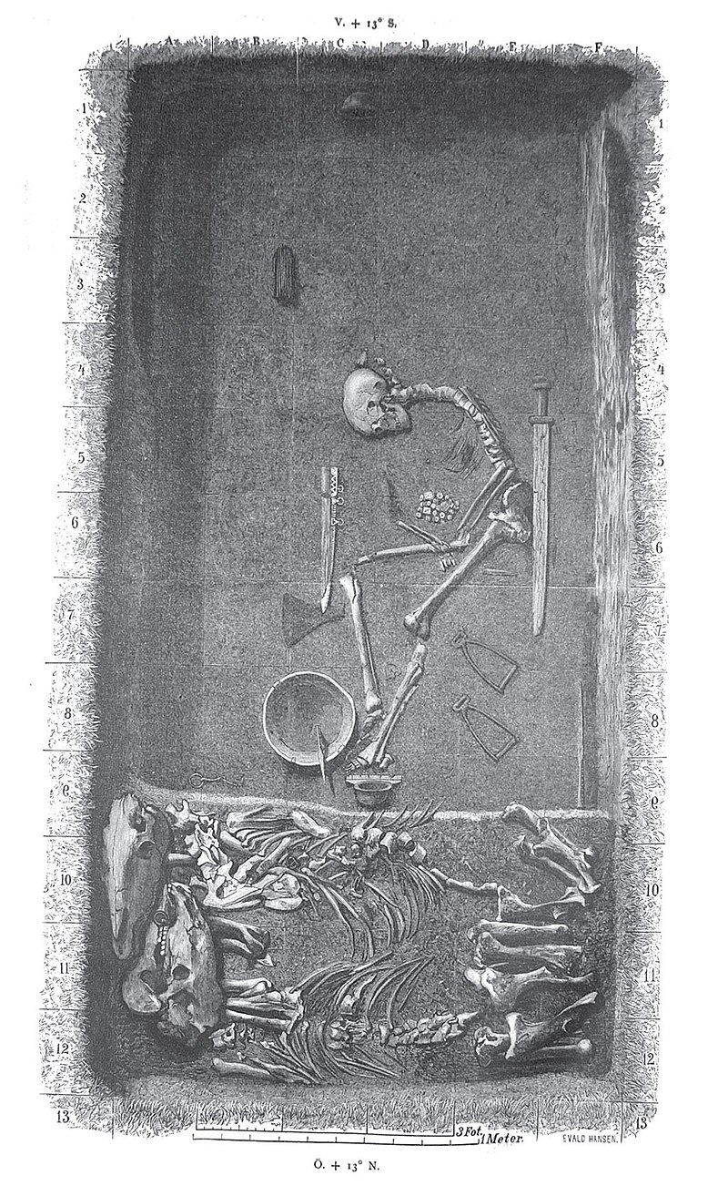
Could Women be vikings?
The Birka Female Vikings Warrior
A viking grave filled with goods associated with elite warriors like swords, horses, shields, axes and game boards (to represent strategy). Originally assumed to be a man, modern tests revealed the body to be a woman’s. Other similar graved have also been found.

Slide 11
Could Women be vikings?
Valkyries and Shield-Maidens
The sagas are viking stories, passed down for hundreds of years before eventually being written down in Iceland. In them, it is quite common to see women warriors (called shield-maidens) and Odin himself employed a kind viking angel, called valkyries, who were great warriors too. Freyja, a Norse Goddess, was also considered a Goddess of War.
An Ancient Norse sculpture, probably of a valkyrie.

Slide 12
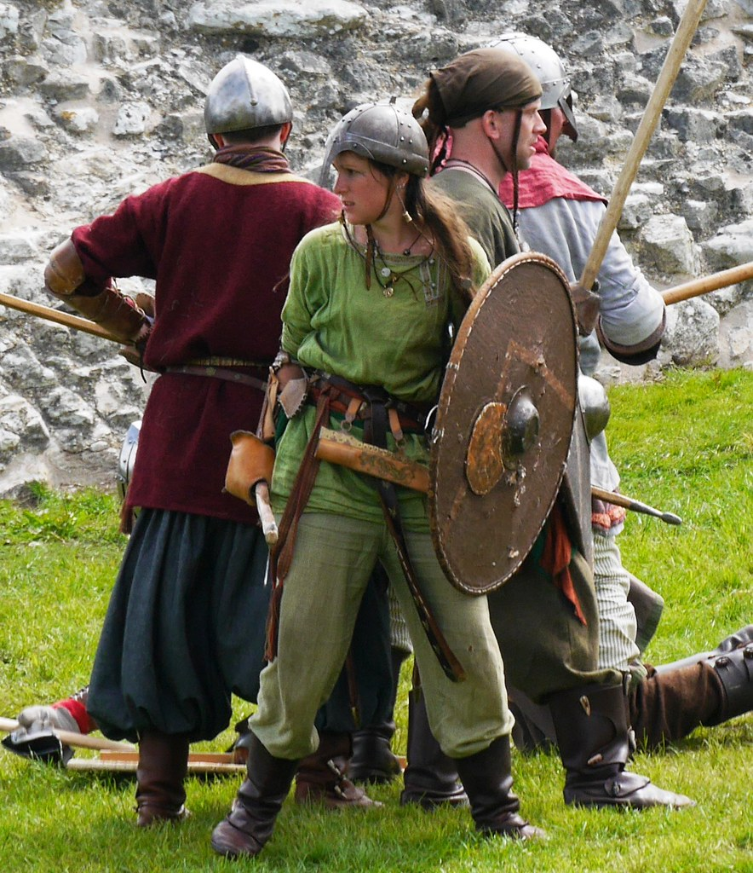
Could Women be vikings?
Accounts from Others
There are also some records from the time from other people who were shocked to find, after a battle, that many of the people they had been fighting against had actually been women. One major example comes from a Byzantine historian, talking about a battle with the Rus (Russian/Ukrainian vikings).

