Slide 1
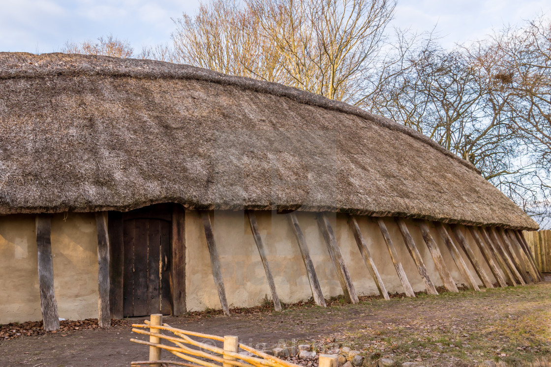
Making a Norse Oil Lamp
This is an Ancient Norse longhouse, and it has everything you would expect on a house… almost. It has walls and a roof and a door, but something is missing…

Slide 2
Windows!
But why? The ancient Norse people knew about glass. Why wouldn’t they want to let in some daylight?
Expense
Need to replace them when they crack
Heat
People Could Break In

Slide 3

Windows!
There are lots of reasons a viking might not want windows in his house, but one of the main ones is heat. Windows let in light, but the glass would have been thin, and heat would have escaped. And Scandinavia is not the warmest place to begin with.

Slide 4
Light
Of Course Not!
So no windows to let in daylight (because they would lose heat), no electric lights (because they hadn’t been invented yet). Did your average Norseman grope around blindly in their house because they couldn’t see where they were going?
So where did they get their light?

Slide 5
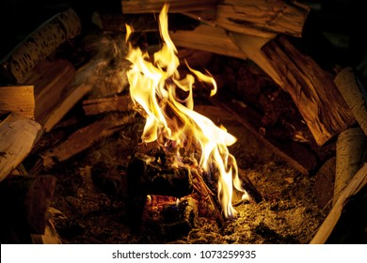
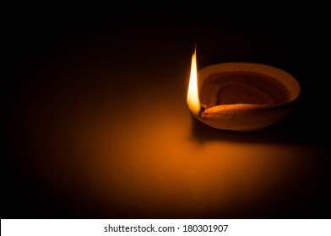
Light
They would have a fire for cooking, of course, but much of their light would have come from lamps. These lamps would have been small containers, made of non-flammable materials like iron or clay, and filled with oil and a wick to light.

Slide 6
Let’s make our own!

Slide 7
Let’s make our own!
If you would like to make it into an experiment, there are a number of variables you could choose to change, and you could measure how long the flame lasts, how bright it is, or both.
The wick
The Lamp
The Oil
You could change the length or the material.
Hemp
String
Cotton
Shoelace
You could change the material or the design.
Tin Foil
Clay
Open
Lid
Fish Oil
Olive Oil
Vegetable Oil
Castor Oil

Slide 8
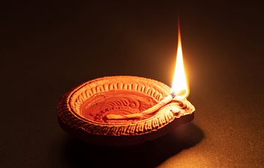
Instructions
- Form your container into a bowl with a lip for a wick to rest in.
- Fill the lamp with the oil of your choice.
- Place the wick in the oil and allow it to soak it up for a minute. The wick should be as close to the oil as possible.
Olive oil can work well. Paraffin and alcohol-based oils will burn very well but the oil can ignite. They would need to be covered and treated very carefully.
Click for my suggestion
- Before lighting, place the lamp on a non-flammable tray, preferably covered in sand.

Slide 9
