Slide 1
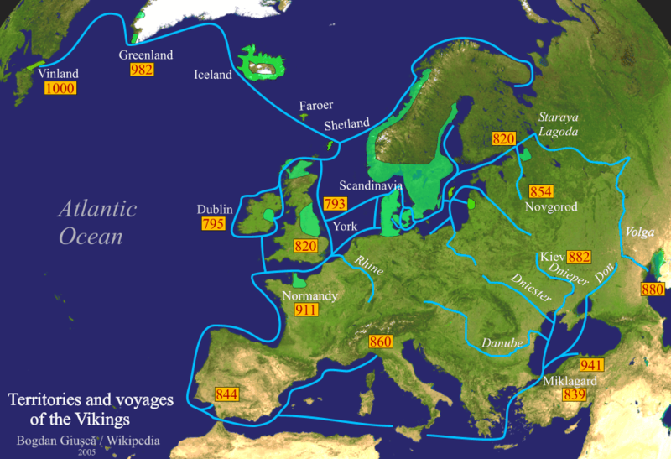
Explorers Extraordinaire!
With their technologically advanced longships, the Ancient Norse people travelled all over the known world, and even discovered new places themselves. As far as Iceland, Greenland and even North America in the West, and Constantinople and Baghdad in the East, they raided, traded and settled.

Slide 2
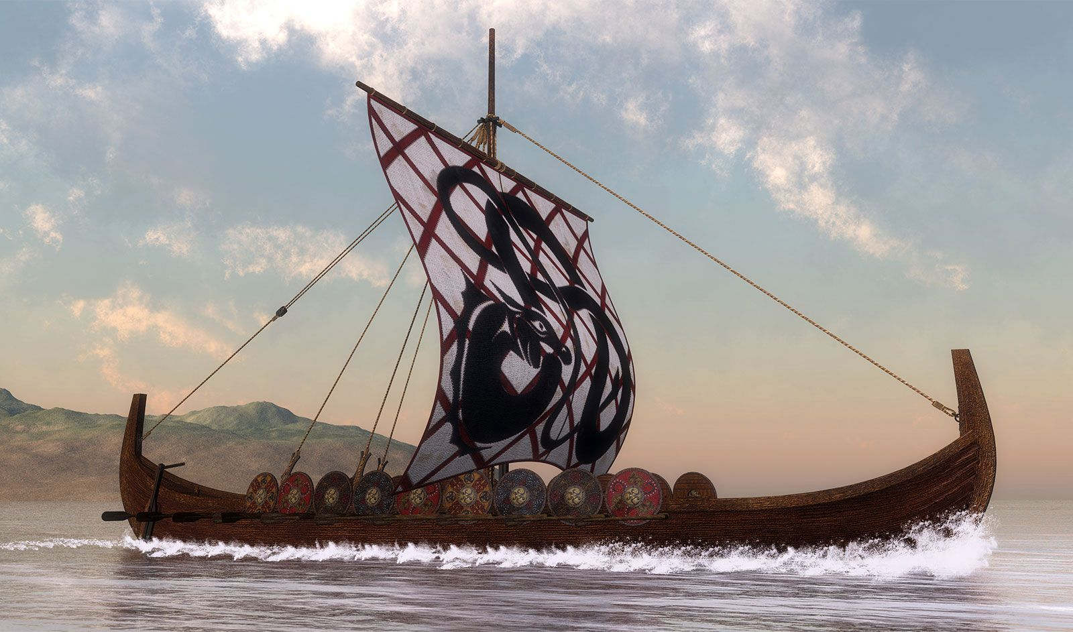
Longboats
The boats were big enough to carry a lot of people and goods, but shallow enough to traverse rivers as well as seas, sleek enough to be fast, and light enough to be carried over land.

Slide 3
What sort of things might they
Traded?
Furs
Weapons
Spices
Iron
People(Thralls)
Jewellery
Wool
Ivory

Slide 4
Different places had different things to trade, so let’s have a closer look sat the map.

Slide 5
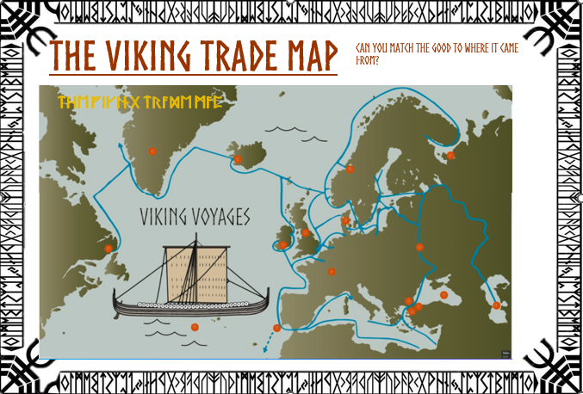
Match the Goods to the place

