Slide 1
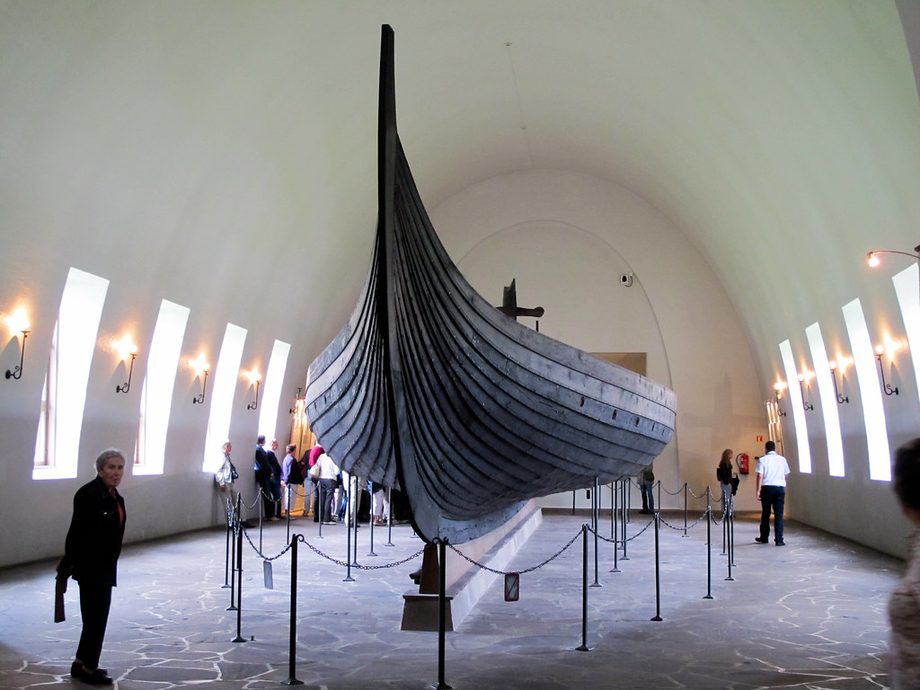
Museums and history
Museums can teach you a lot about history, but how do they (or anyone else for that matter) know about things that happened so long ago?

Slide 2
How do we know about the past?
We draw from many different sources when learning about the past.
First hand accounts
Works of other historians
Accounts from others at the time
Oral History
Archaeology
Artwork
Science

Slide 3
How do we know about the past?
We draw from many different sources when learning about the past.
First hand accounts
Works of other historians
Accounts from others at the time
Oral History
Archaeology
Artwork
Science

Slide 4
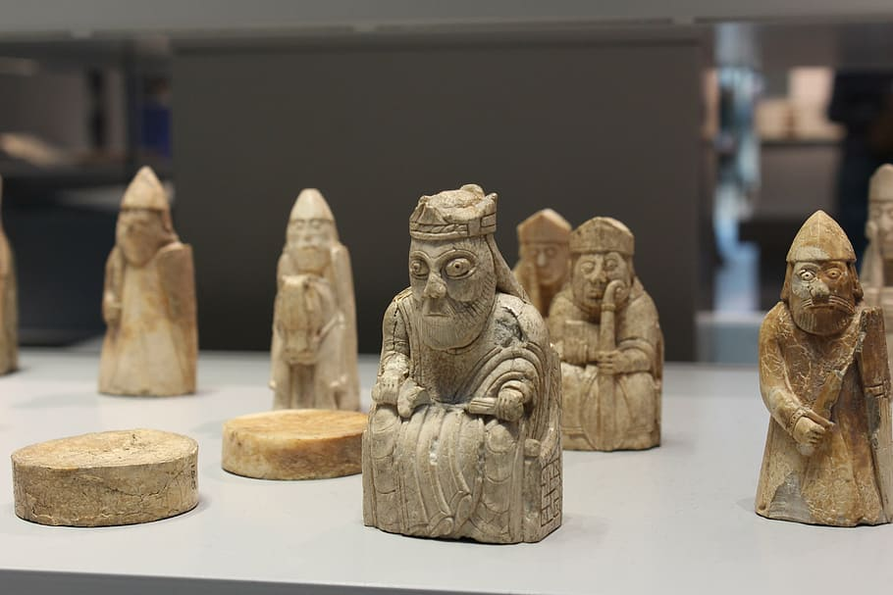
Artefacts
Archaeology
Artefacts from the time that we dig up. Grave good are especially useful.
Museums specialise in artefacts and archaeology. Past civilisations, including the Vikings, left a lot of things buried in the ground, and we can learn a lot from them.
Grave goods (things the dead are buried with) are especially useful, but so are the everyday things that are left behind.

Slide 5
Could you be an archaeologist?
Archaeologist have to take great care when digging up artefacts so that they don’t damage them. They then have to come to conclusions about the people the objects belonged to.
task
Your job is use the tools of your trade to dig into the sand and retrieve your artefacts then tell us what they might tell you about they people who left them behind.

Slide 6
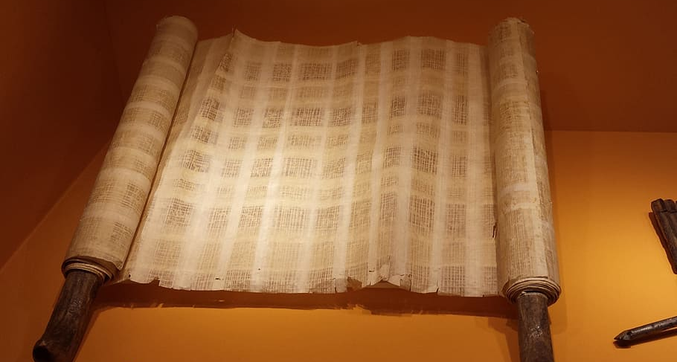
Other sources
Of course, it’s not just the physical objects and traces that historians use to learn about the past. They use lots of different Primary and Secondary Sources to do so.
Primary Sources
Secondary Sources
Information someone or something that was there for the event. Artefacts, diaries, autobiographies etc.
Information from someone who has learned it from someone or something else. History books, Wikipedia articles, account from people at the time who weren’t there.

Slide 7
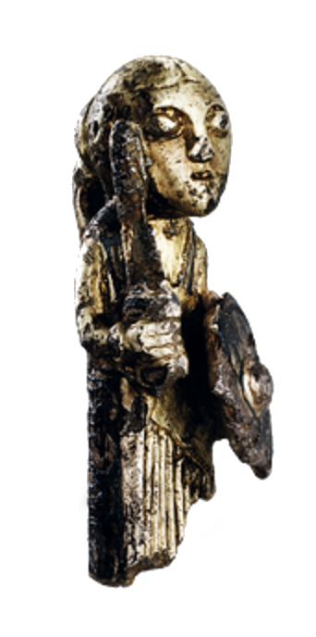
Sources
Accounts from others at the time
Vikings didn’t write much down at the time but others did and some of the visited, lived with or fought against the vikings.
Letters, diaries and other writings from people who were there at the time.
First Hand Accounts
Oral History
Stories passed down through the generation that are eventually written down.
Artwork
Runestones, carvings, models and other art.
Science
Carbon dating, DNA tests etc.

Slide 8
Why might be primary sources be more useful?
But…
If people experienced something themselves, we don’t need to worry as much about things being made up, misremembered or misunderstood as they were passed from person to person.
People can still misremember. Secondary sources can benefit from looking at lots of primary sources to get more than one angle on events. They are also less likely to be biased.

Slide 9
What is bias?
For various reasons, someone might not be able to judge things completely fairly. They might not be impartial.
For example, they might be on a certain ‘side’ or their loved ones might be involved.

Slide 10
Some of the people involved are your friends or family.
You prefer one side because of country, religion, ideology, football team etc.
What do we mean by bias?
You want a particular outcome for personal reasons.
You have already decided before you hear all sides.
You are affected by stereotypes (e.g. to do with race, gender, class etc.?

Slide 11
Spot the bias
‘The ref must have been blind to make that decision!’ – Man U manager Ole Gunnar Solskjaer.
Book: Cars – Dangerous Death Machines by Sally Arkwright (the UK’s biggest stable owner)
‘Guy Fawkes should be executed at once!’ – King James I.
‘I don’t think we need to hear any evidence. Look at him, he looks very guilty indeed.’ – Judge Moore.

Slide 12
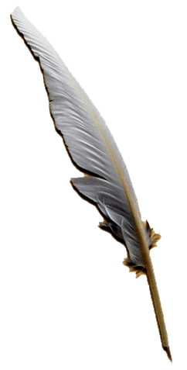
Bias Task
To explore the idea of bias, we’re going to split the class in half. Everyone is going to write a short diary entry about a viking attack.
Half of you will write from the point of view of the attacking vikings. The other half from the point of view of the Anglo-Saxons who are under attack.
Think, in particular, about how your describe the vikings who are attacking.

