Slide 1
Thralls and Viking Classes
The jarls (earls) at the top were the lords who ruled over people.
.
The karls were
The Ancient Norse People split their society into three broad classes, into which everyone belonged.
Jarls
Karls
freemen and women.
.
The thralls were slaves.
Thralls

Slide 2
Haven’t we seen this before?
It is a sad fact that before the 1800s, almost every civilisation had slaves of one kind or another and in the Viking Age, they were more important to their society than at almost any other point in history.
Jarls
Karls
Thralls
To tend the farms and do other menial jobs, a lot of people were needed, especially if some of the men were going to be away on raids.

Slide 3
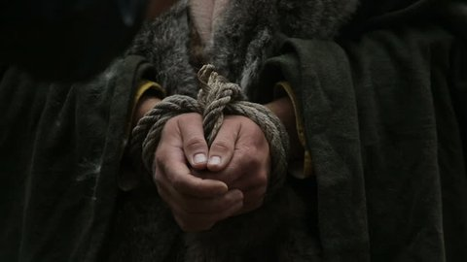
Thralls
Many people at the time saw thralls as not just necessary but right and natural. They thought that the gods had created a society with different classes, and that people rightfully belonged in those classes, with all the jobs they entailed.
People became thralls through a few different ways. Some were captured as prisoners in wars and raids (many came from Britain and Ireland), many were born to two thrall parents, some had committed a crime and made a thrall as a punishment, and some even became a thrall willingly to pay off debts.

Slide 4
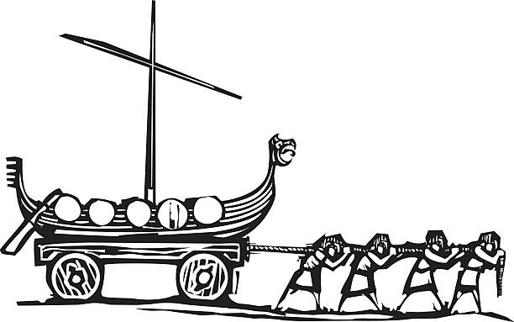
Freedom
Thralls could become free, either by buying themselves from their masters with money that they earned or by being freed by those same masters, often as part of a will.
Even then, it wasn’t a full freedom though. They belonged to an in between class, expected to vote with their masters and be loyal to them.
How a thrall was treated depended on their master and where and when they lived. Some were treated well, paid, wore nice clothes and even held power. Some were treated very badly. They were hit, made to sleep with the animals and treated like animals themselves. The law protected them a little, but most still had tough lives.

Slide 5
English Task
You are the thrall from chapter 5. Using what you know about thralls, and how she is described in the story, you are going to write a piece from her perspective. This can be her travelling to or from Rognvald and Inga’s home, it can be during the ritual or it can be her doing other duties at another time.
No matter what she is doing, though, you will describe her emotions and thoughts. She might be thinking about the ritual or about her master, how she is going to become free or how she became a thrall in the first place.

Slide 6
Conjunctions
Conjunctions are words that connect ideas together. They take simple sentences and turn them into longer compound or complex sentences. Simple sentences are good, but too many of them can make your writing sound dull and stop-start. Adding a conjunction can take a simple idea and add depth and detail or even a bit of twist.
They can be simple words that we use all the time. These aren’t bad and they aren’t boring. In fact, authors will use these more than any others too.
Others are a bit rarer, but still do the same job of connecting ideas and expanding sentences.
And
But
Because
So
Or
Then
Although
However
Meanwhile
Whereas
Therefore

Slide 7
Sentence Starters
Can you finish these sentences in interesting ways?
- I wanted to run and escape from her for good, but
- The raiders had charged at me with their axes, so
- Although I knew the secrets of her magic,
- The boy’s eyes widened and

Slide 8
More Sentence Starters
- As I began to sing, I thought back to…
- Every time the volva looked at me, my stomach…
- I didn’t know how I would do it, but one day…
- I carefully placed the chair on the table, knowing that if I did it incorrectly…
- The boy was looking at me like he’d never seen a thrall before and I…

