Slide 1
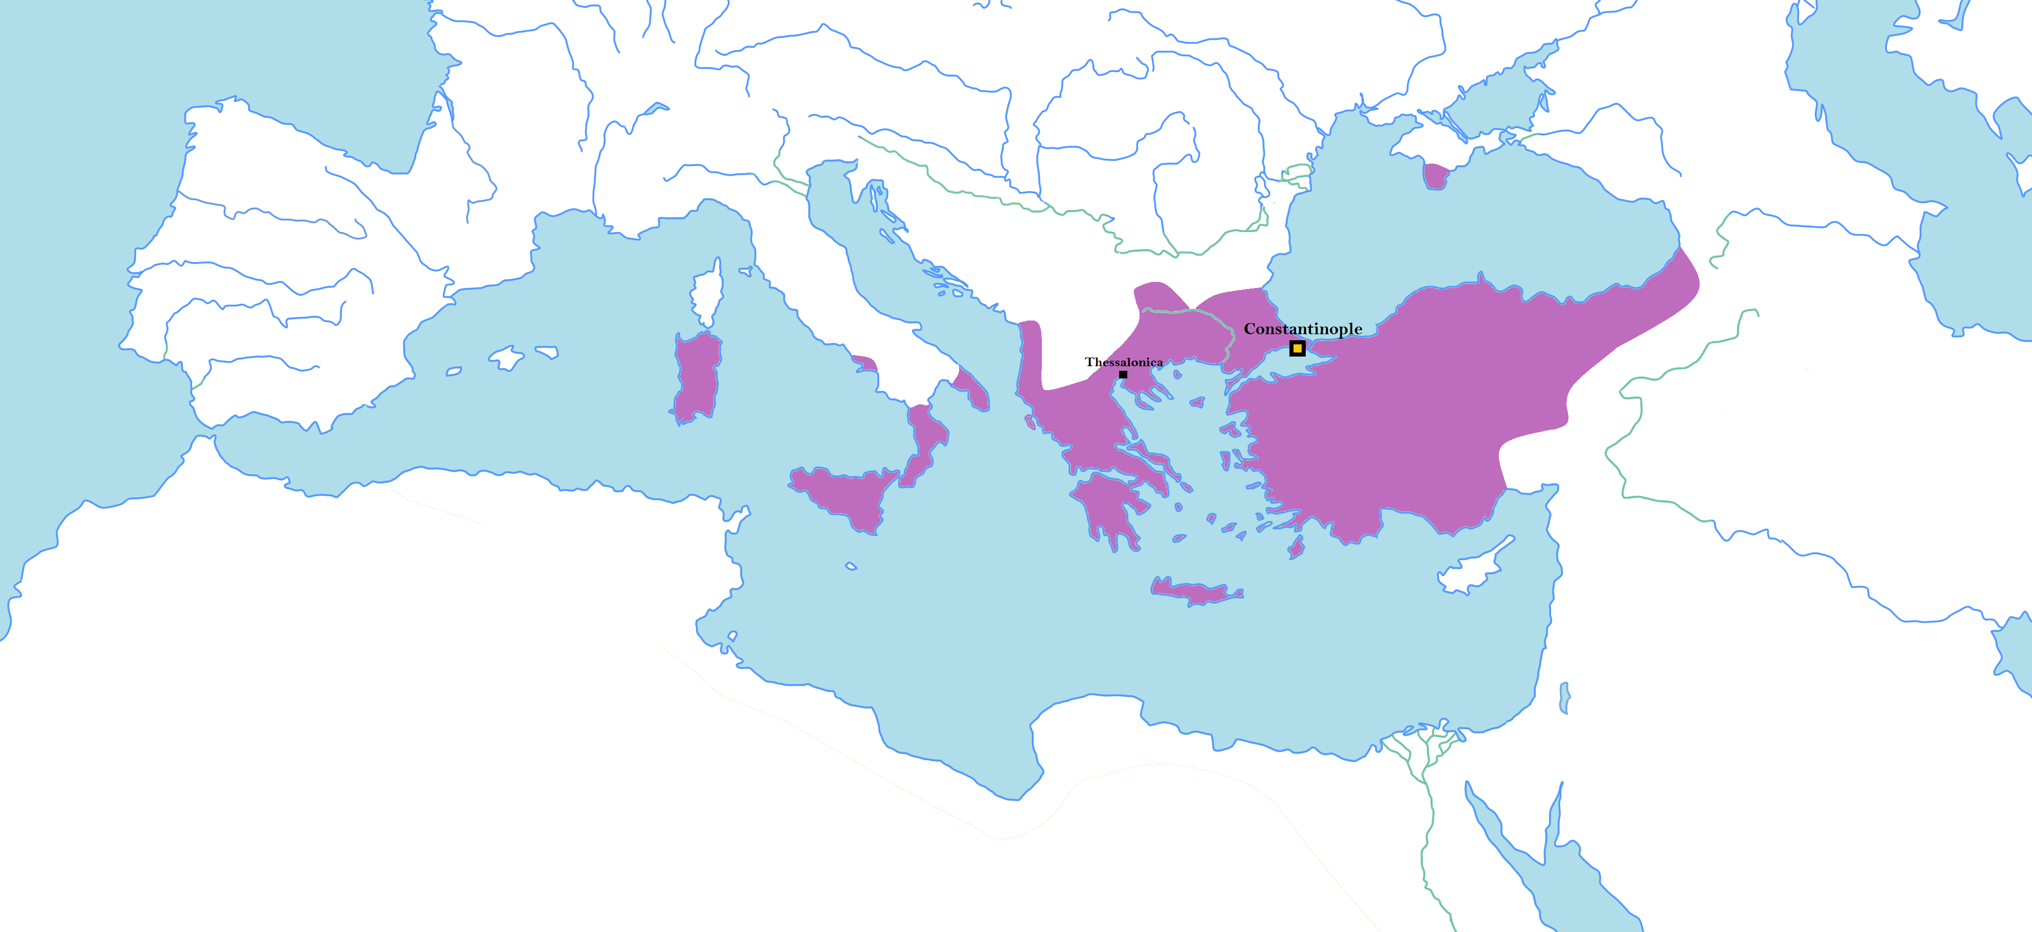
The byzantine empire
The Byzantine Empire is another name for the Eastern Roman Empire. After the fall of the Western Empire around the year 500, the Eastern Empire, which had previously split off, carried on as a powerful entity in its own right.
Its capital was in Constantinople (now Istanbul) in modern day Turkey, Freya and Chester’s ultimate destination in the viking world.

Slide 2
What does this have to do with vikings?
Constantinople was a major trading hub, and the biggest city in the world for part of the Viking Age. Many Ancient Norse people traded their goods there, everything from furs, leather and fish to treasure and even thralls (slaves) taken by the vikings.
Beyond that, many vikings found work in Constantinople as part of an elite group of soldiers…

Slide 3
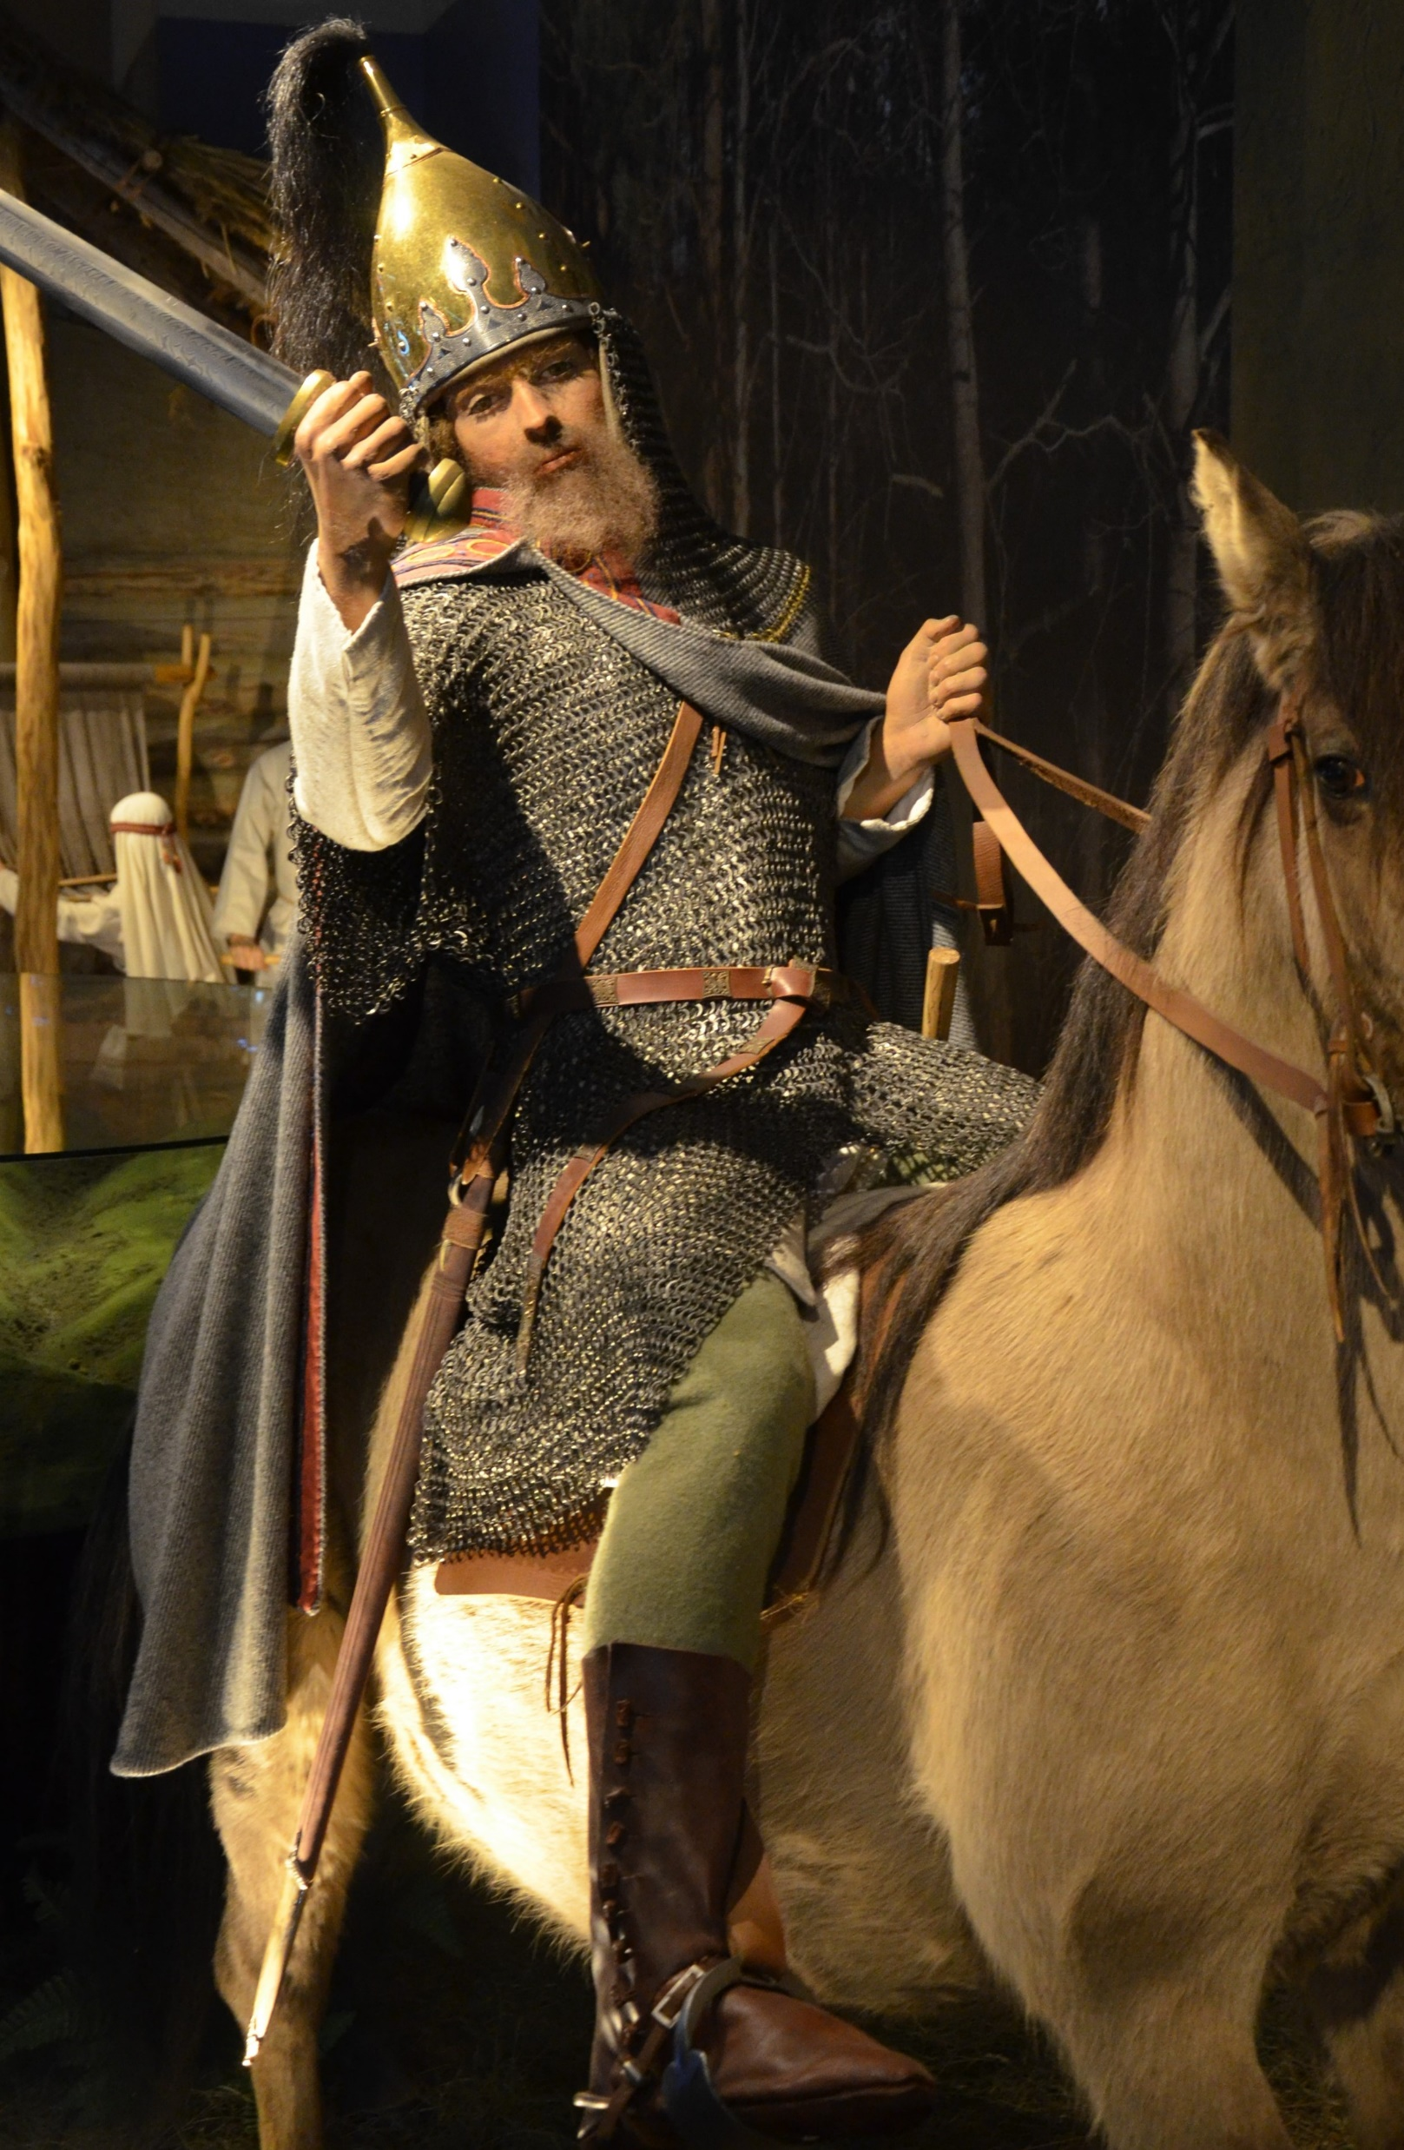
The varangian guard
From the early 800s onwards, the Byzantine Emperor started to recruit skilled foreign fighters to be part of his own personal guard. The first to join were the Rus: Norse people who had settled lands in modern Ukraine and Russia, not so far from Constantinople. Vikings from Scandinavia and Anglo-Saxons from England, among others, soon followed in signing up with the guard.

Slide 4
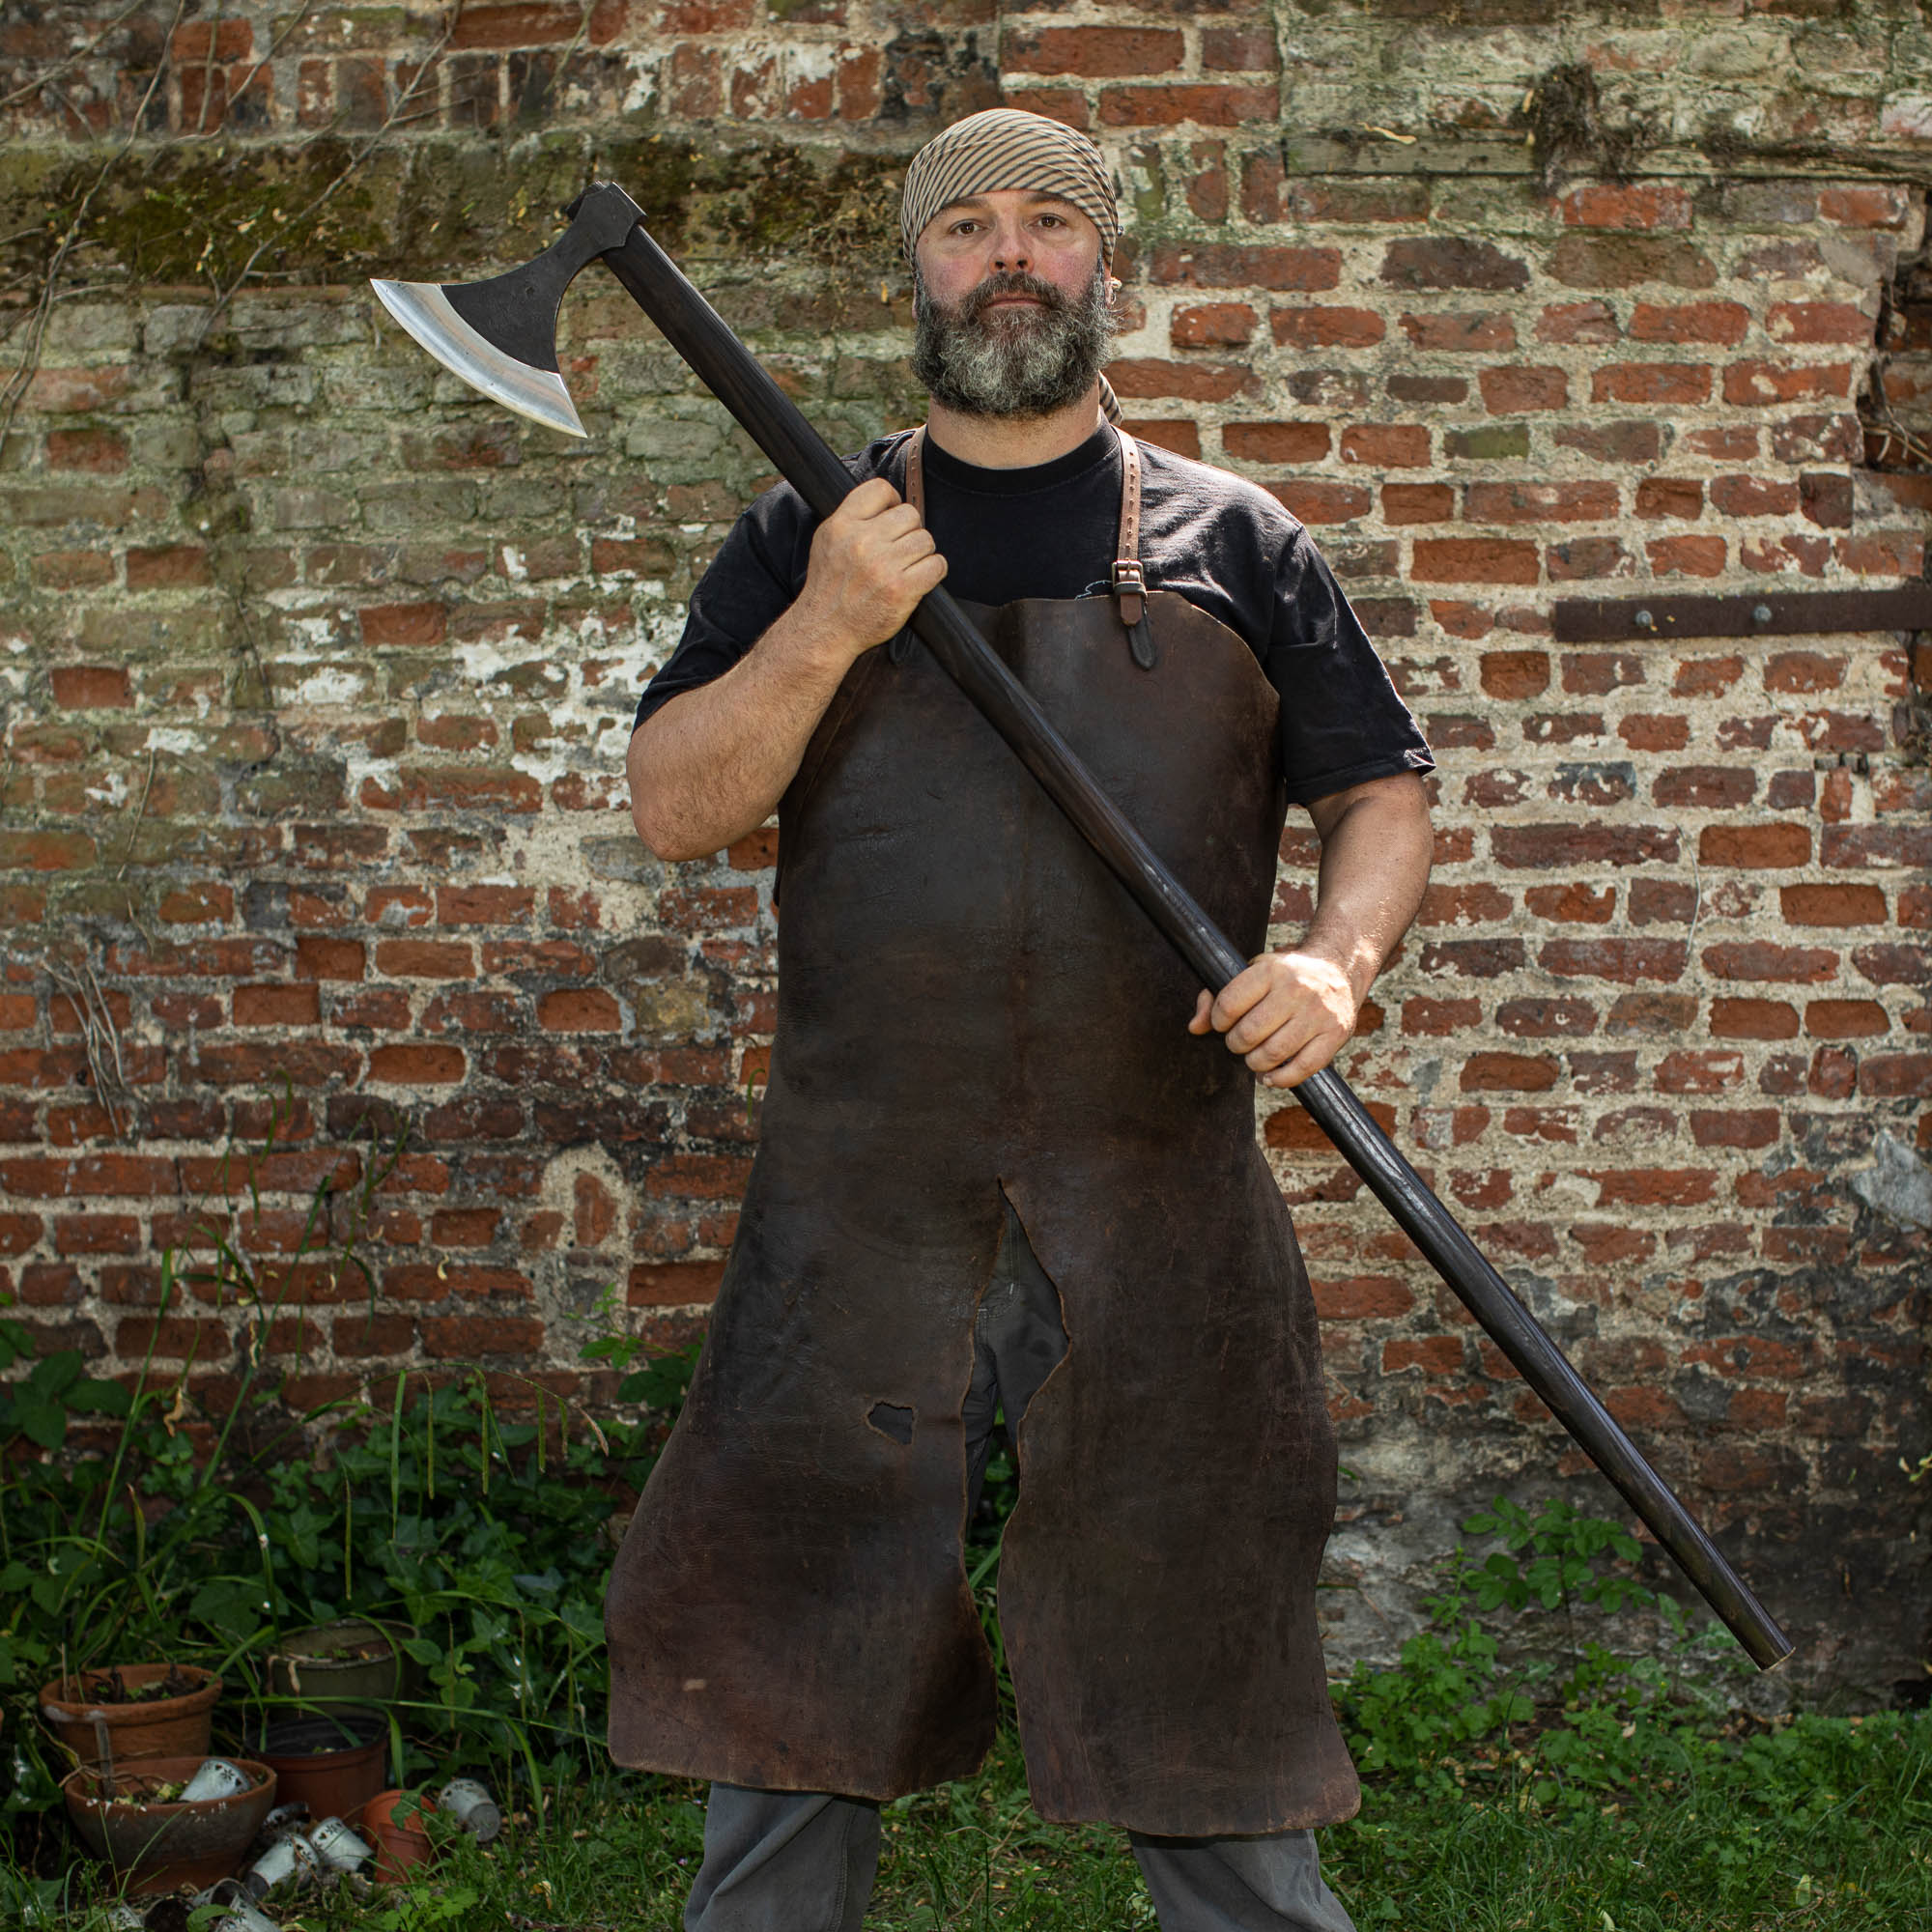
The best of the best
The Varangian Guard were known for being elite, skilled and powerful warriors. They served as the Emperor’s personal bodyguard, but also fought for him in wars and invasions. Renowned for fighting with their huge and fierce Dane Axes, they were feared throughout the known world.
Emperors liked to employ vikings because they wouldn’t have their own political beliefs about the Empire and who should be in charge. They would be loyal to the person who was paying them. They were also, of course, famously good fighters.

Slide 5
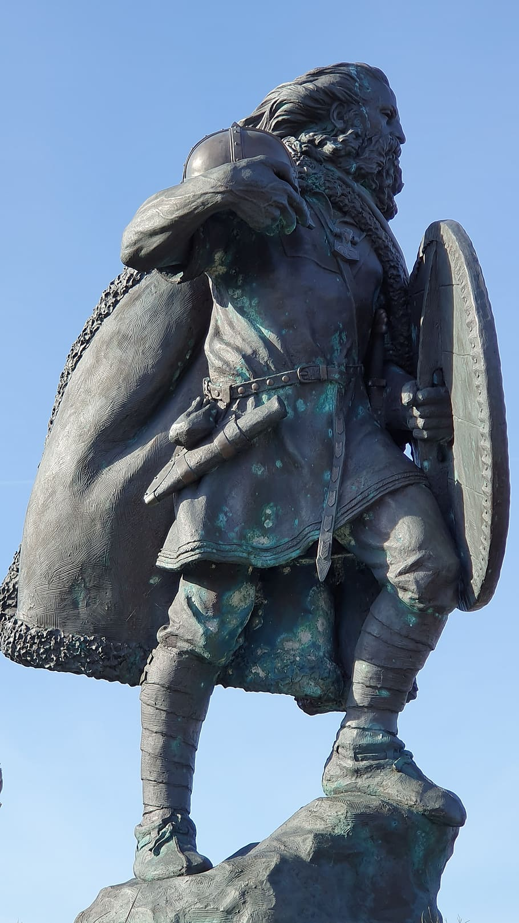
Norse Legends
Probably the most famous member of the Varangian Guard was none other than Harald Hardrada himself. A giant of a man and a great fighter and leader, he amassed a large fortune while serving as the Commander of the Guard, which he later used to help him seize the throne of Norway. As King of Norway, he also invaded England in 1066, hoping to become king there as well. Whether or not he was successful is another story.

Slide 6
Applying for a job
You are a viking. Famous for your skill and ferocity in battle, you have decided that you want a steady job. Working in the Varangian Guard, you would be paid well, have a level of protection and be given the best weapons and equipment.
task
Write a letter to the Byzantine Emperor applying for a job as part of the Varangian Guard. Explain why you want it and why you would perfect for the job.

