Slide 1
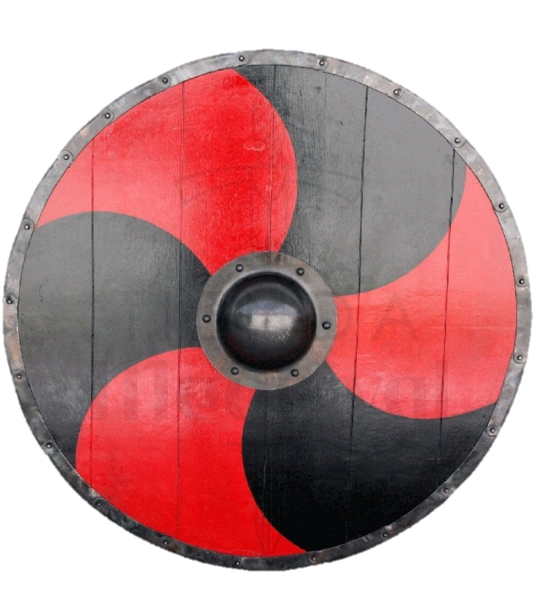
Viking glue
Glue might not seem like the most exciting thing the vikings ever made, but it was very important. It was a vital part of making two of their most iconic objects: their shields and their ships, alongside countless other things.
To make their shields, viking stuck planks of wood together before cutting it into shape. They also glued on leather or rawhide to strengthen it.
Glue helped waterproof their ships as well.

Slide 2
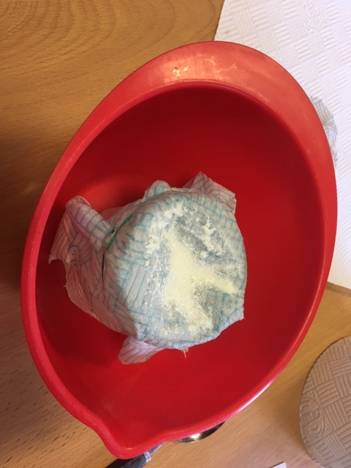
Viking glue
The Ancient Norse people made different glues from many different materials, but an easy and surprisingly effective method was using milk, vinegar and sodium bicarbonate.
Why don’t we have a go at making some of our own?

Slide 3
Recipe
Method:
Pour 100ml of milk into a mixing bowl and add three dessert spoons of bicarbonate of soda.
Wait until the curds and whey separate. This should only take a few minutes, but heating the mixture can speed it up if you’re impatient.
Filter out the whey through the kitchen roll and scrape the curds (the solid bits) onto separate piece of kitchen roll. Gently pat it dry.
Crumble the curds into a clean bowl and mix in three teaspoons of bicarbonate of soda.
Slowly add teaspoons of water, mixing each time until it forms a smooth, thick paste.
You will need:
100ml Milk
Vinegar
Sodium Bicarbonate
Bowl
Measuring Jug
Kitchen Roll
Spoons

Slide 4
Testing the glue
So we have our glue, but what good is any glue if it doesn’t stick.
We need to test it!
Can you think of a way we can test our viking glue against other glues to see how they compare in terms of strength?

Slide 5
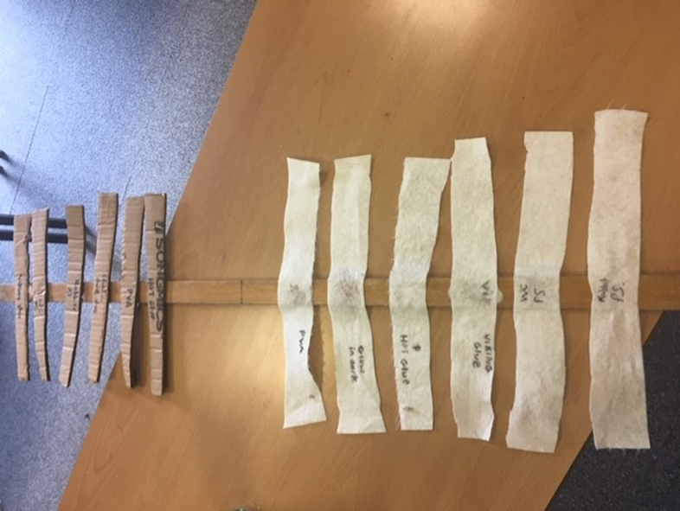
Testing the Glue
One way to test it is to glue pieces of cardboard or fabric onto a long solid surface (such as a metre ruler).
Collect different glues to test the viking glue against, such as glue stick, PVA and superglue. Each glue can be assigned to one or two pieces of the cardboard or fabric, or perhaps one of each to test the effectiveness on different materials.
Hang a paper cup by string from each of the materials.
Add controlled amounts of sand, rice, marbles, coins or weights, one by one, to each cup.
Track the amount of weights each glue holds before it is ripped off.
Have more cups on standby because (without spoilers) some of the glues can hold a surprising amount of weight before they give way.

