Slide 1
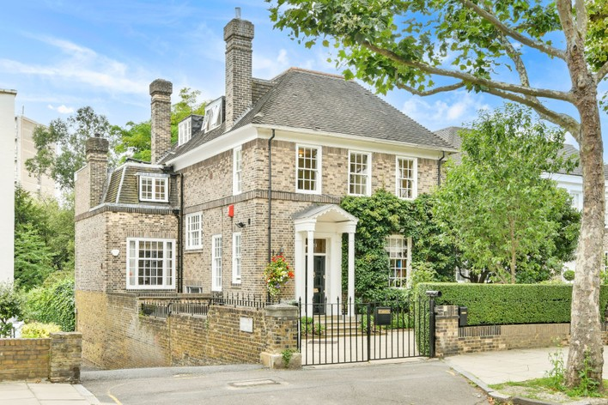
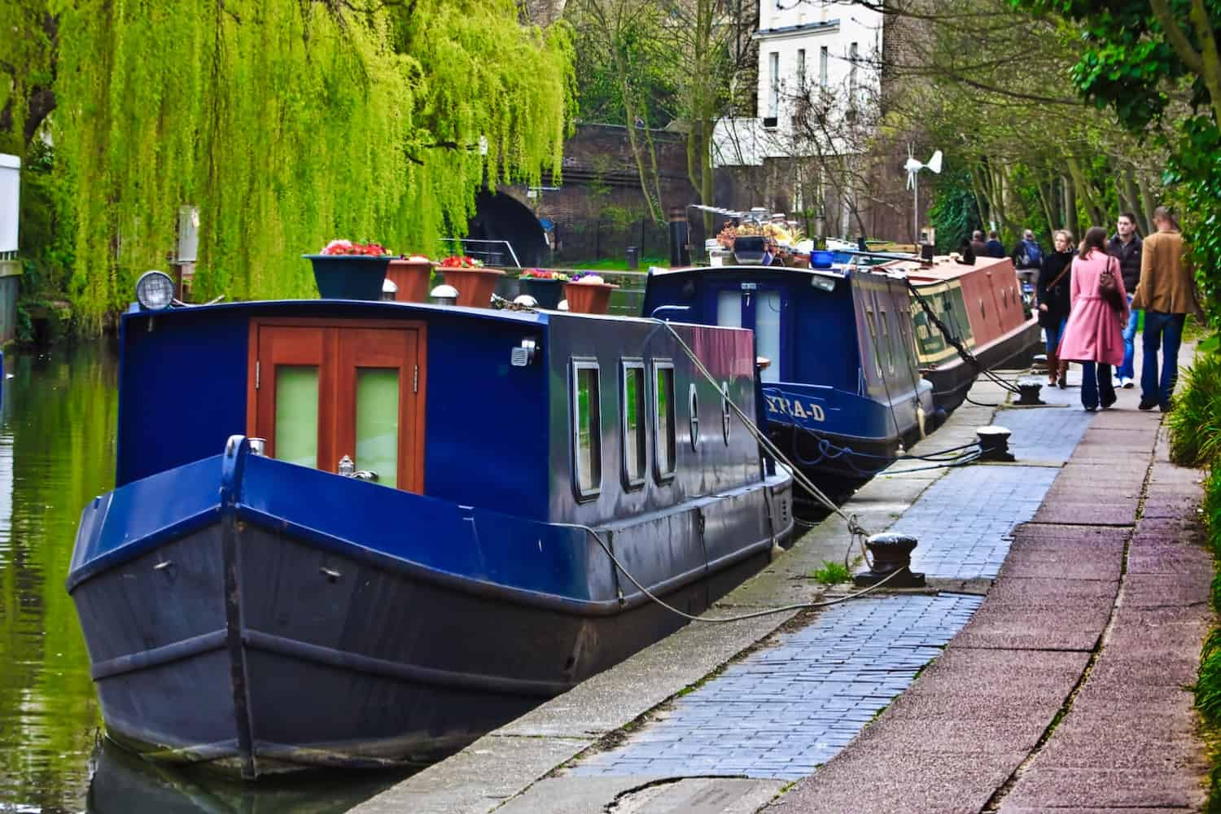
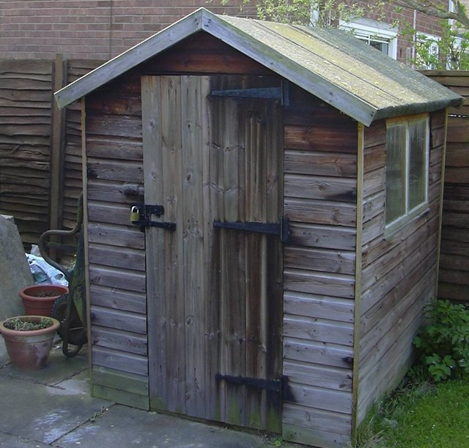
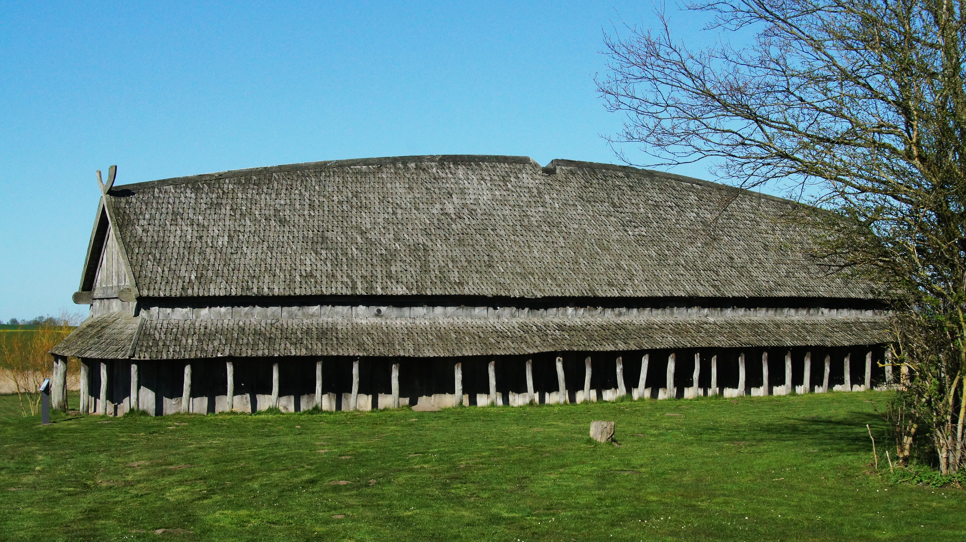
Where did Ancient Norse People Live?
(It’s this one)

Slide 2
Viking Longhouse
The Viking Age lasted for over 250 years and stretched across most of the known world so, obviously, not everyone’s house looked the same. It was very common, though, for Ancient Norse people to live in a longhouse.
Fun Fact!
It’s called a longhouse because it’s a house that’s long.

Slide 3
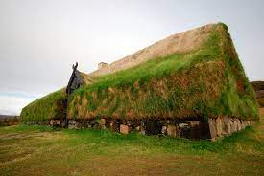
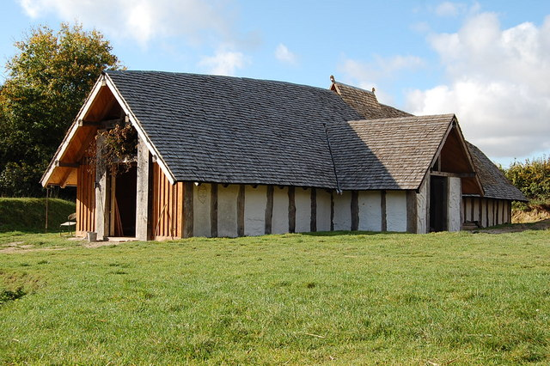
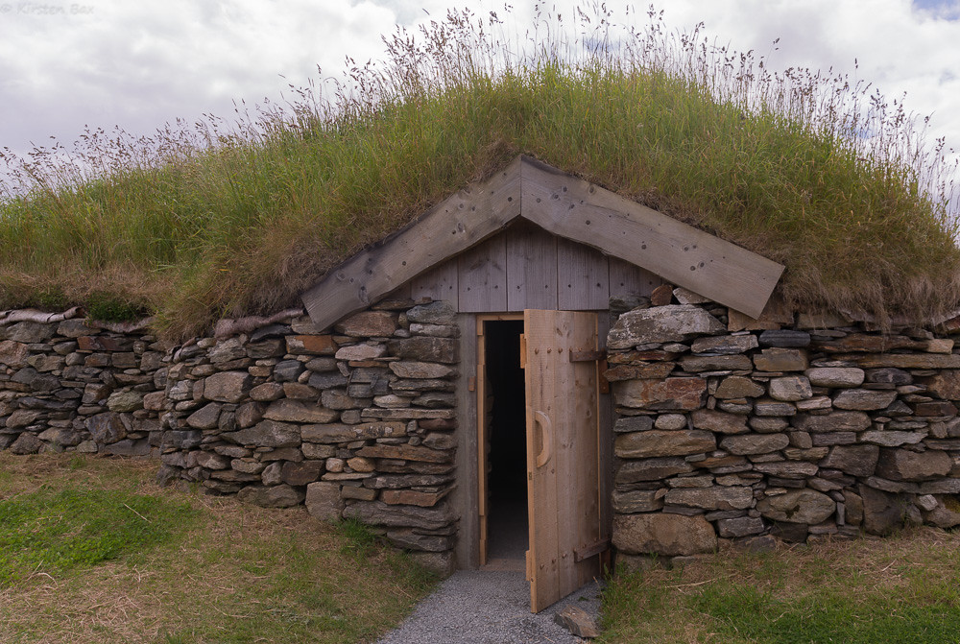
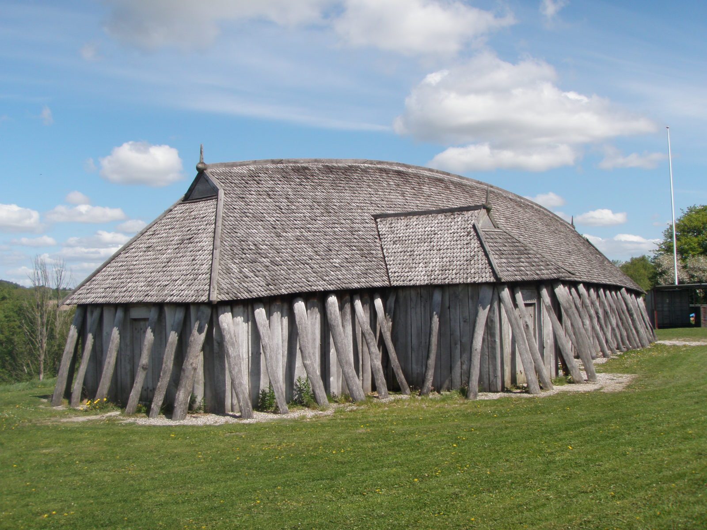
Viking Longhouse
Longhouses were made out of materials that were available in the local area and that would protect the people inside from the elements. Most would have been made out of wood, but stone and turf were also known. The roof also varied. Sometimes it was thatched, sometimes made of slate and sometimes, again, wood or turf.

Slide 4
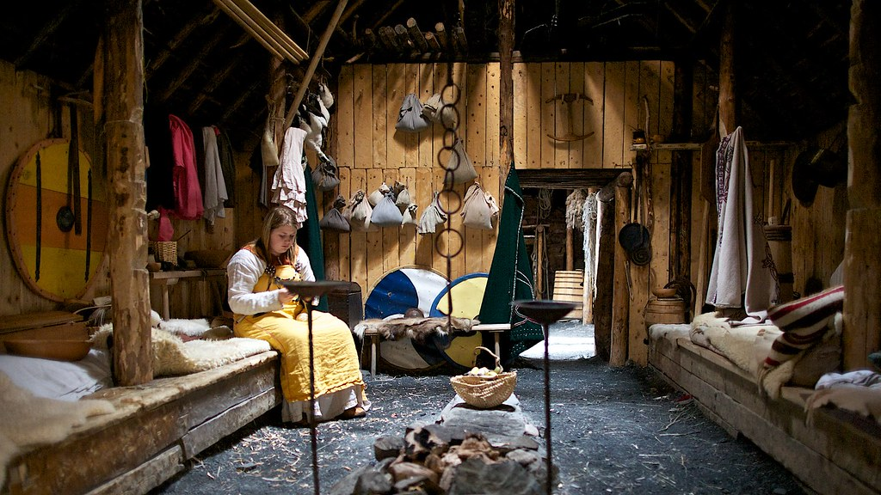
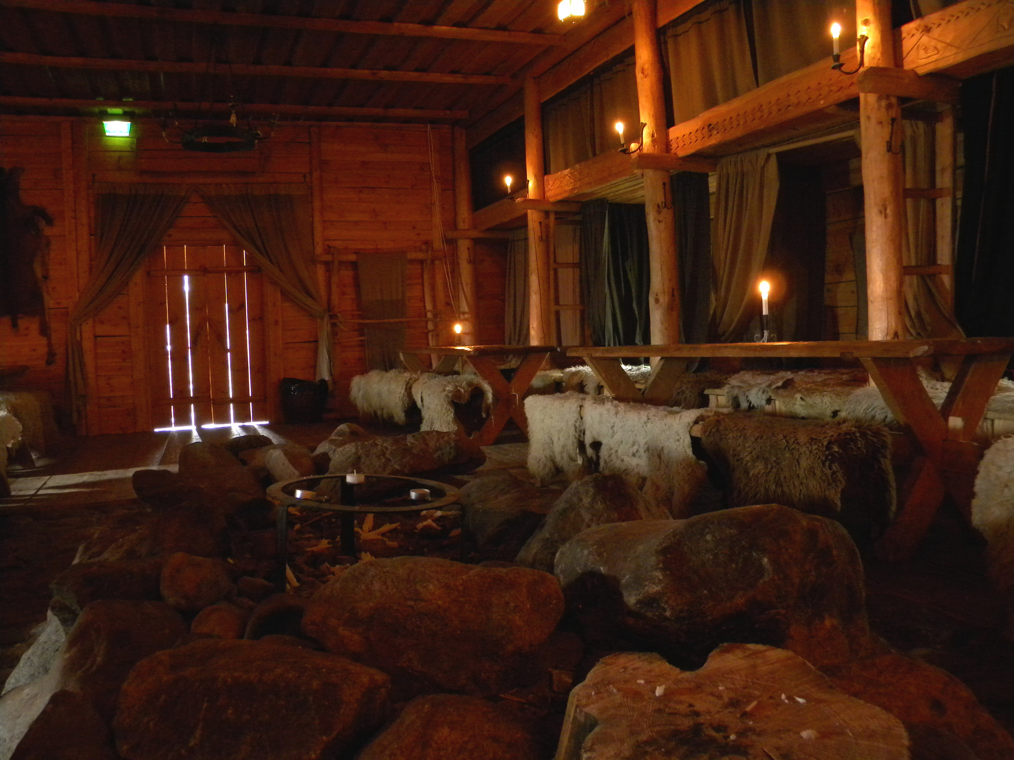
Viking Longhouse
Inside, Norse people lived, slept, cooked, worked and played. An open fire in the middle would have served as an oven, with pots hung over it. A loom would have been common so that the women and girls (mostly) could make clothes. Usually, it would have been one big room, with space sitting and beds made of straw and heather.

Slide 5
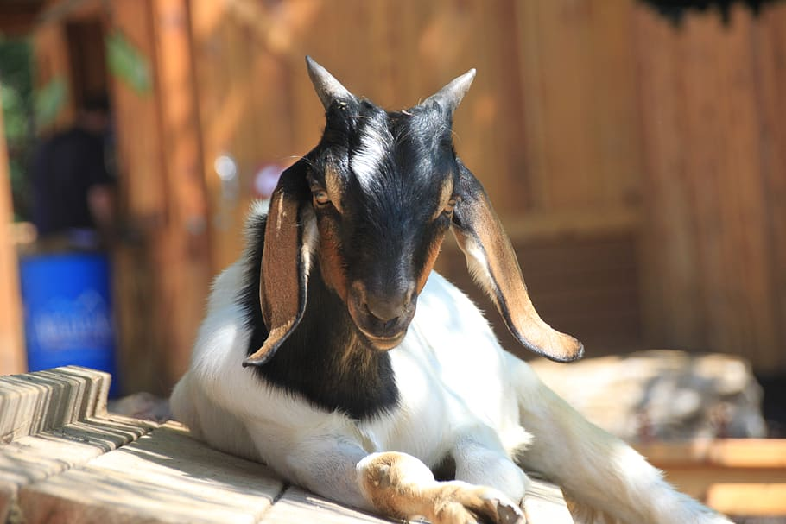
Don’t forget your roommates!
If it sounds like it would get a bit crowded with the whole family in one big room, you haven’t seen anything yet! During the winter, Norse people would often bring their animals inside to live with them in the warmth of the house. That could mean living and sleeping with pigs, sheep, chickens, goats and more. Imagine the smell!

