Slide 1
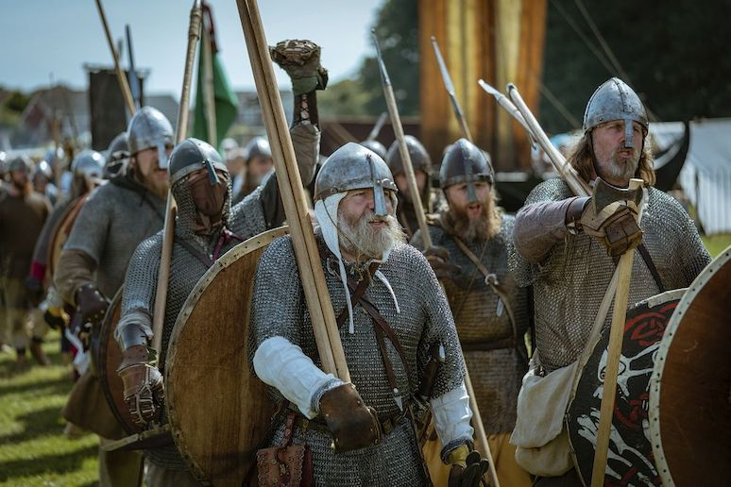
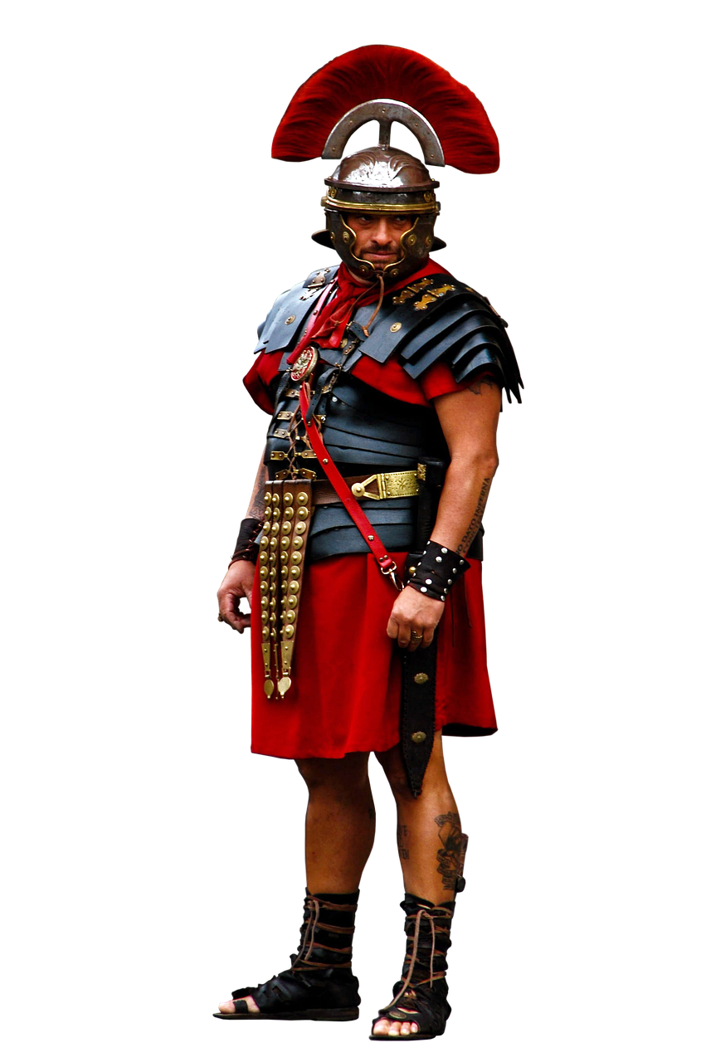
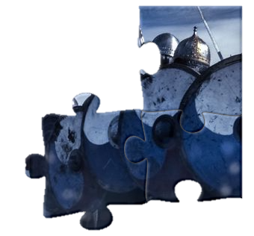
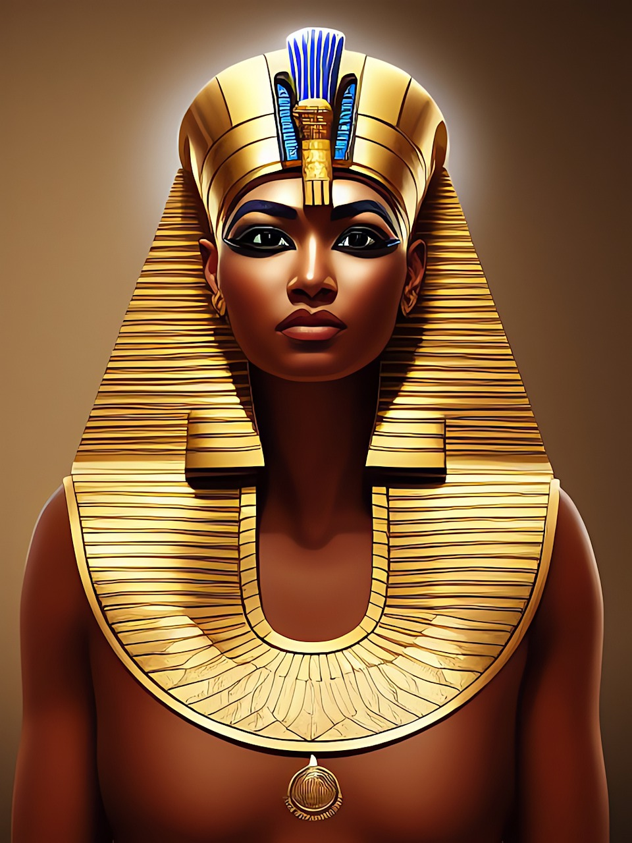
When Were the Vikings?
Let’s put the vikings into context!
We’ve all heard of the Vikings. Fierce raiders…big shields…axes…longboats etc. etc.
But where exactly to they fit in the puzzle?
Before this guy?
Or him?

Slide 2
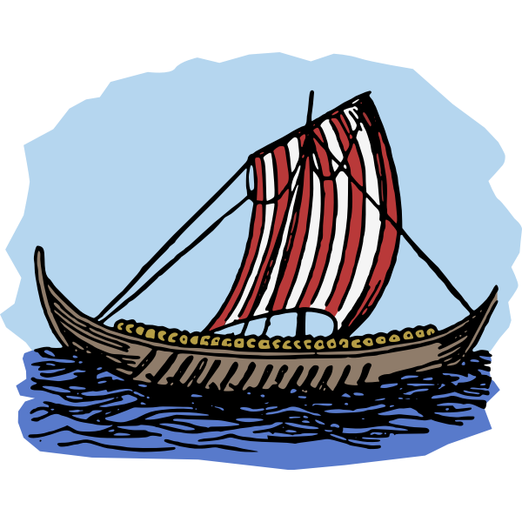
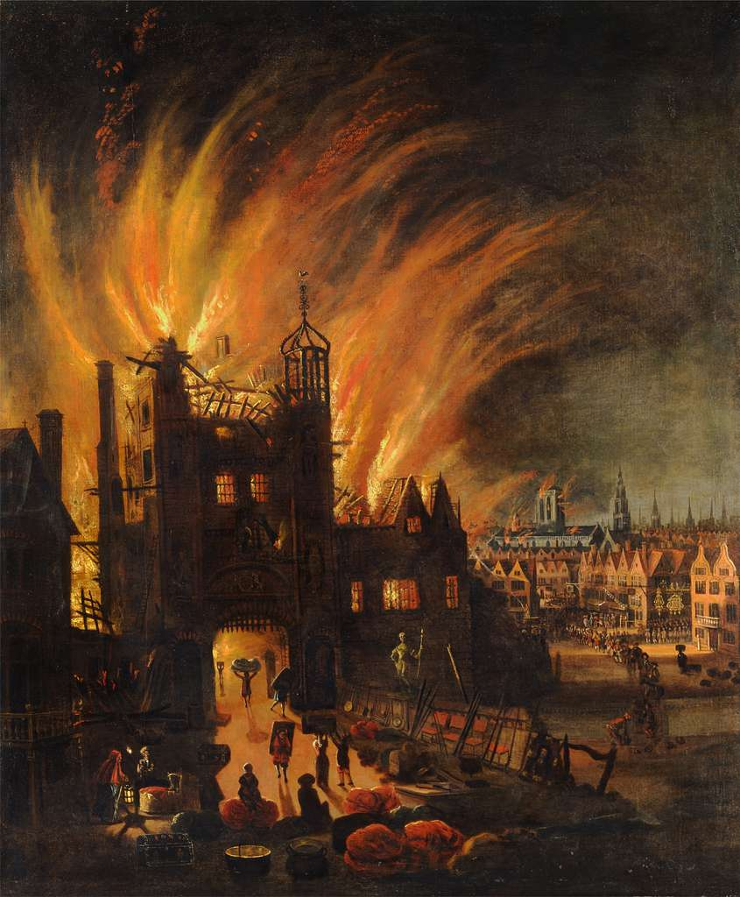
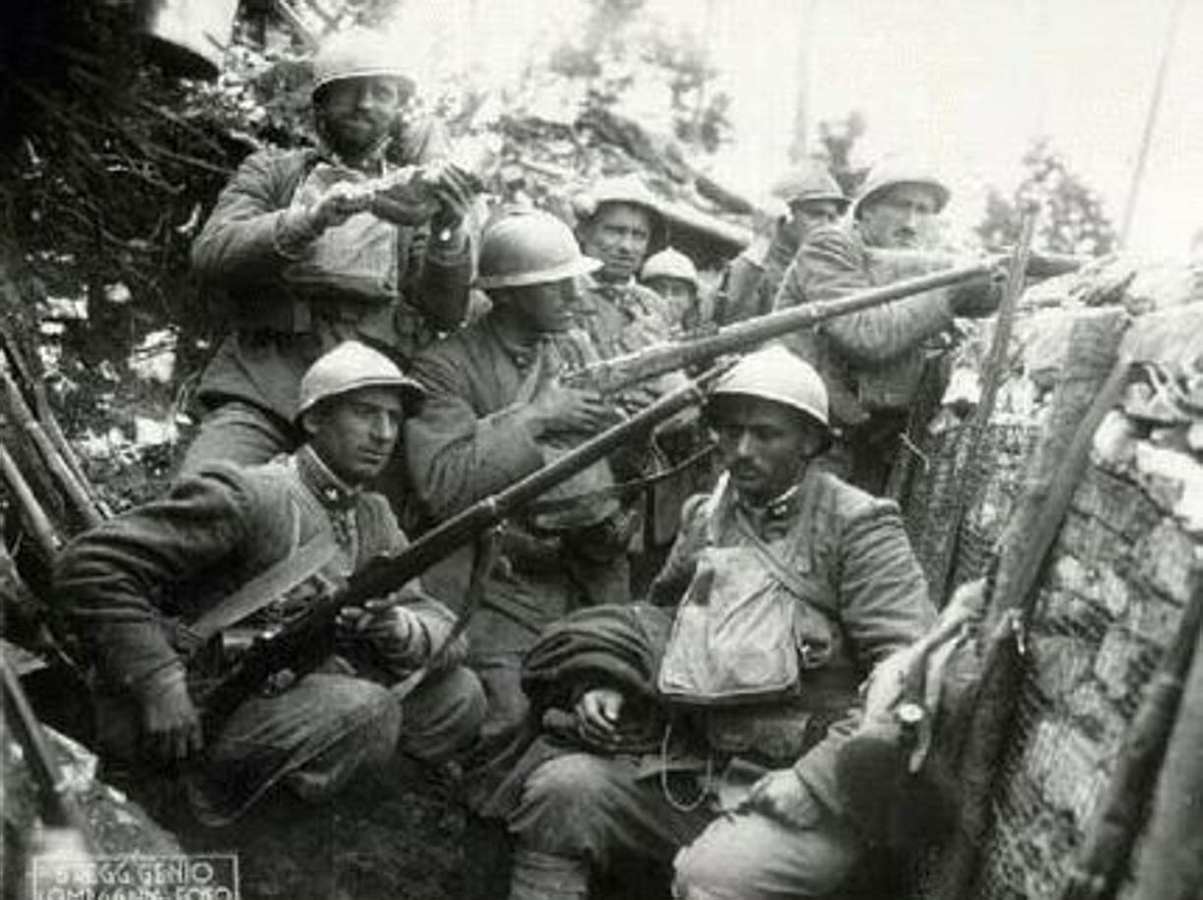
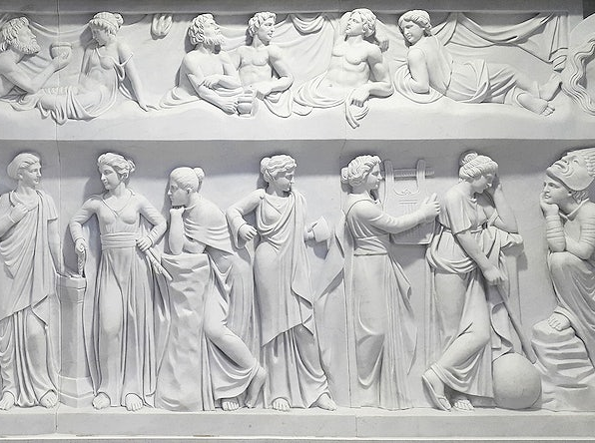
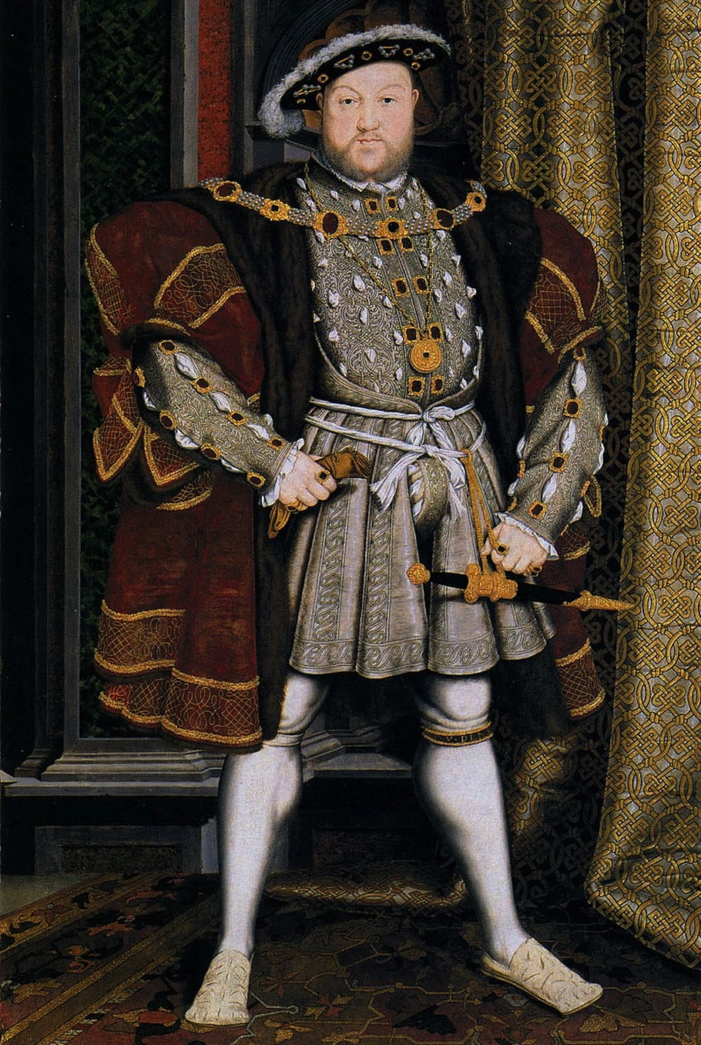
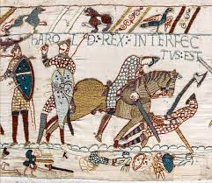
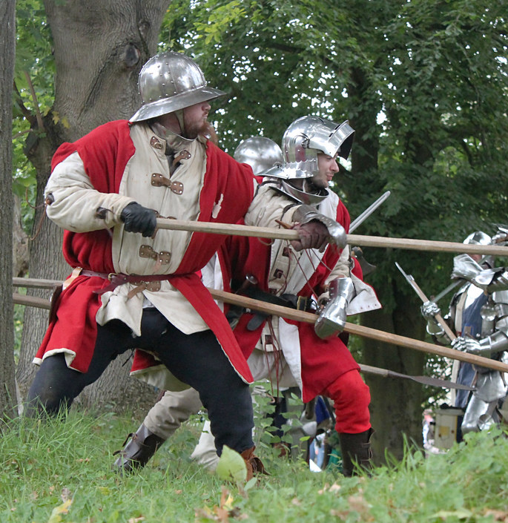
Click on the question mark that you think shows
the correct place for the Vikings on the timeline.
Great Fire of London
World War 1
Ancient Egypt
Ancient Greece
Battle of Hastings
Wars of the Roses
Correct!
Tudors
Romans

Slide 3
~3100 BC-1069 BC
~752 BC-476 AD
1066
1485-1603
1914-1918
~800 BC-600 AD
793-1066
1455-1487
1666

Slide 4
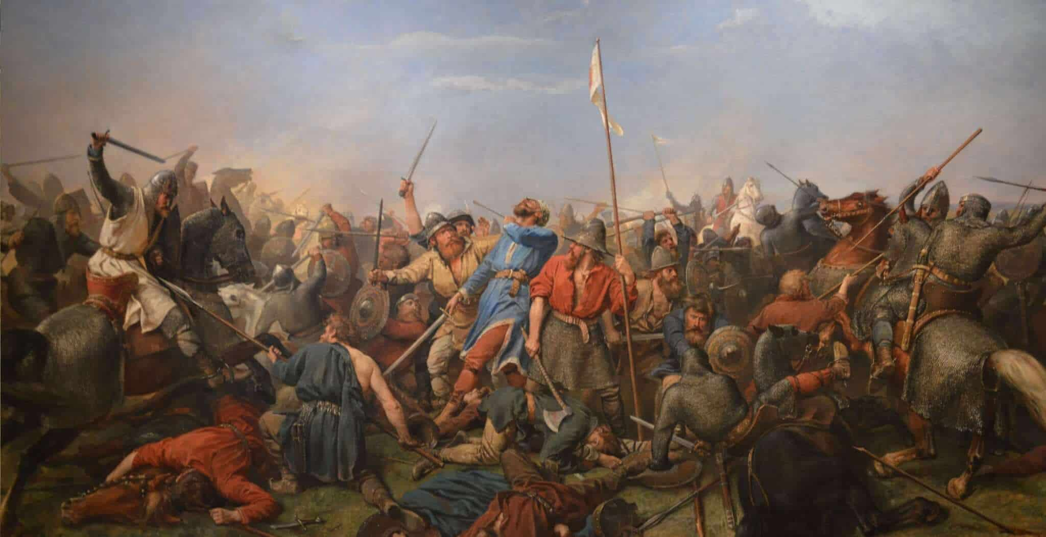
When Were the Vikings?
We usually say that the Viking Age started in 793 with the famous raid on the Holy Island of Lindisfarne.
It ended in 1066, when the viking king, Harald Hardrada was killed at the Battle of Stamford Bridge

Slide 5
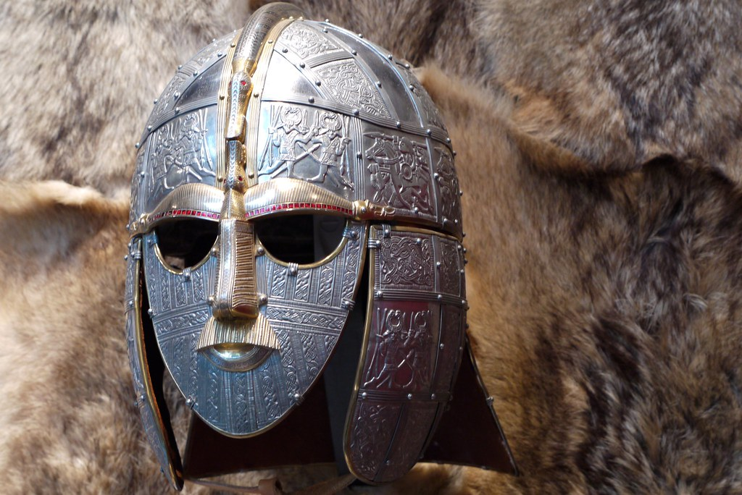
When Were the Vikings?
They coincided with the Anglo-Saxons of England, and the Normans of France, and fought many battles and raids against both of them.

