Slide 1
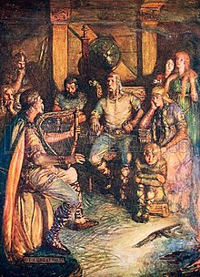
The Skalds
The Ancient Norse people weren’t really big on writing. Religious myths, stories, poems and even laws were passed down by word of mouth.
That meant that the keepers of these important things were vital to the Norse way of life.
Just as law-sayers passed down the laws of the land, skalds passed down the stories and poems.

Slide 2
Kennings
In skaldic poetry, the kenning was an important device. Kennings are metaphors – ways of referring to something without using its name, but in away that is descriptive and evocative. We still use them sometimes today:
Ankle-biter
Small child
Bookworm
Someone who reads a lot.
Treehugger
Someone who cares about the environment.

Slide 3
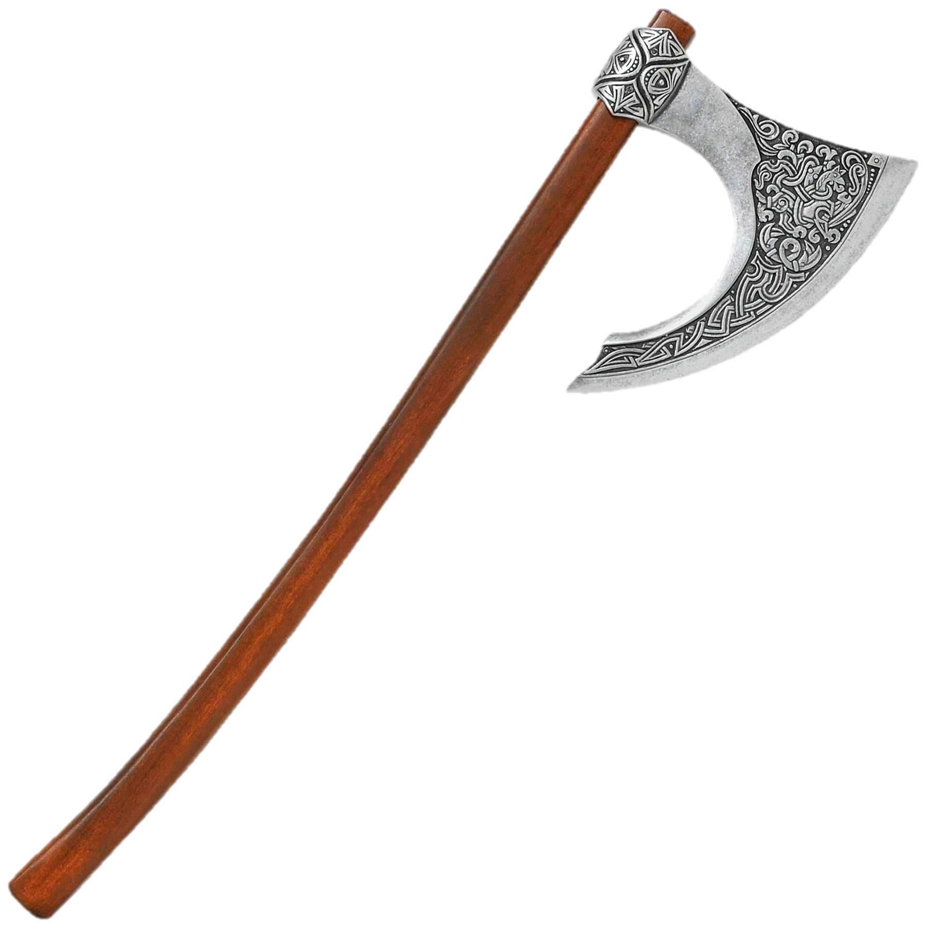
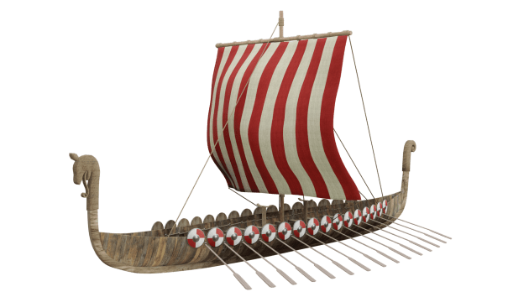
Kennings
They are most often two words put together to describe what that thing does.
For example:
How about an axe?
Skull-splitter?
Longship – Wave-horse
Let’s have a go at some of our own kennings!
What else could a longship be?

Slide 4
Fronted adverbials
A skald would not last long if they used boring language and started every sentence the same way. Fronted adverbials are friends to good skalds everywhere.
A fronted adverbial goes at the front of the sentence and it acts like an adverb, meaning it describes the verb.
It gives more description and tells us when, where or how something is being done.

Slide 5
Fronted adverbials
Gently,
she lifted the sleeping baby.
I ate my breakfast.
the panther struck.
the ground began to shake.
I lost my coat.
Before Sunrise,
Without warning,
Suddenly,
At the park,

Slide 6
A Skaldic Poem
We’re going to write a short piece of skaldic poetry. It doesn’t have to rhyme, but it should tell part of an epic story inspired by Norse legend. And let’s include some kennings and fronted adverbials.
Some ideas:
Thor Fighting Giants
A Viking Raid
Valkyries Taking Someone to Valhalla
An Encounter with a Dragon
Loki Pulling a Trick
A Duel Against Fenrir

Slide 7
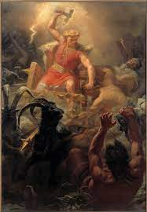
A Skaldic Poem
Here is a starter, let’s finish it together as an example.
With great fury, Thor seized his skull-crusher from the ground and slinked towards the giant. The earth-shaker simply stared at him, unmoved. Like a lion…

