Slide 1
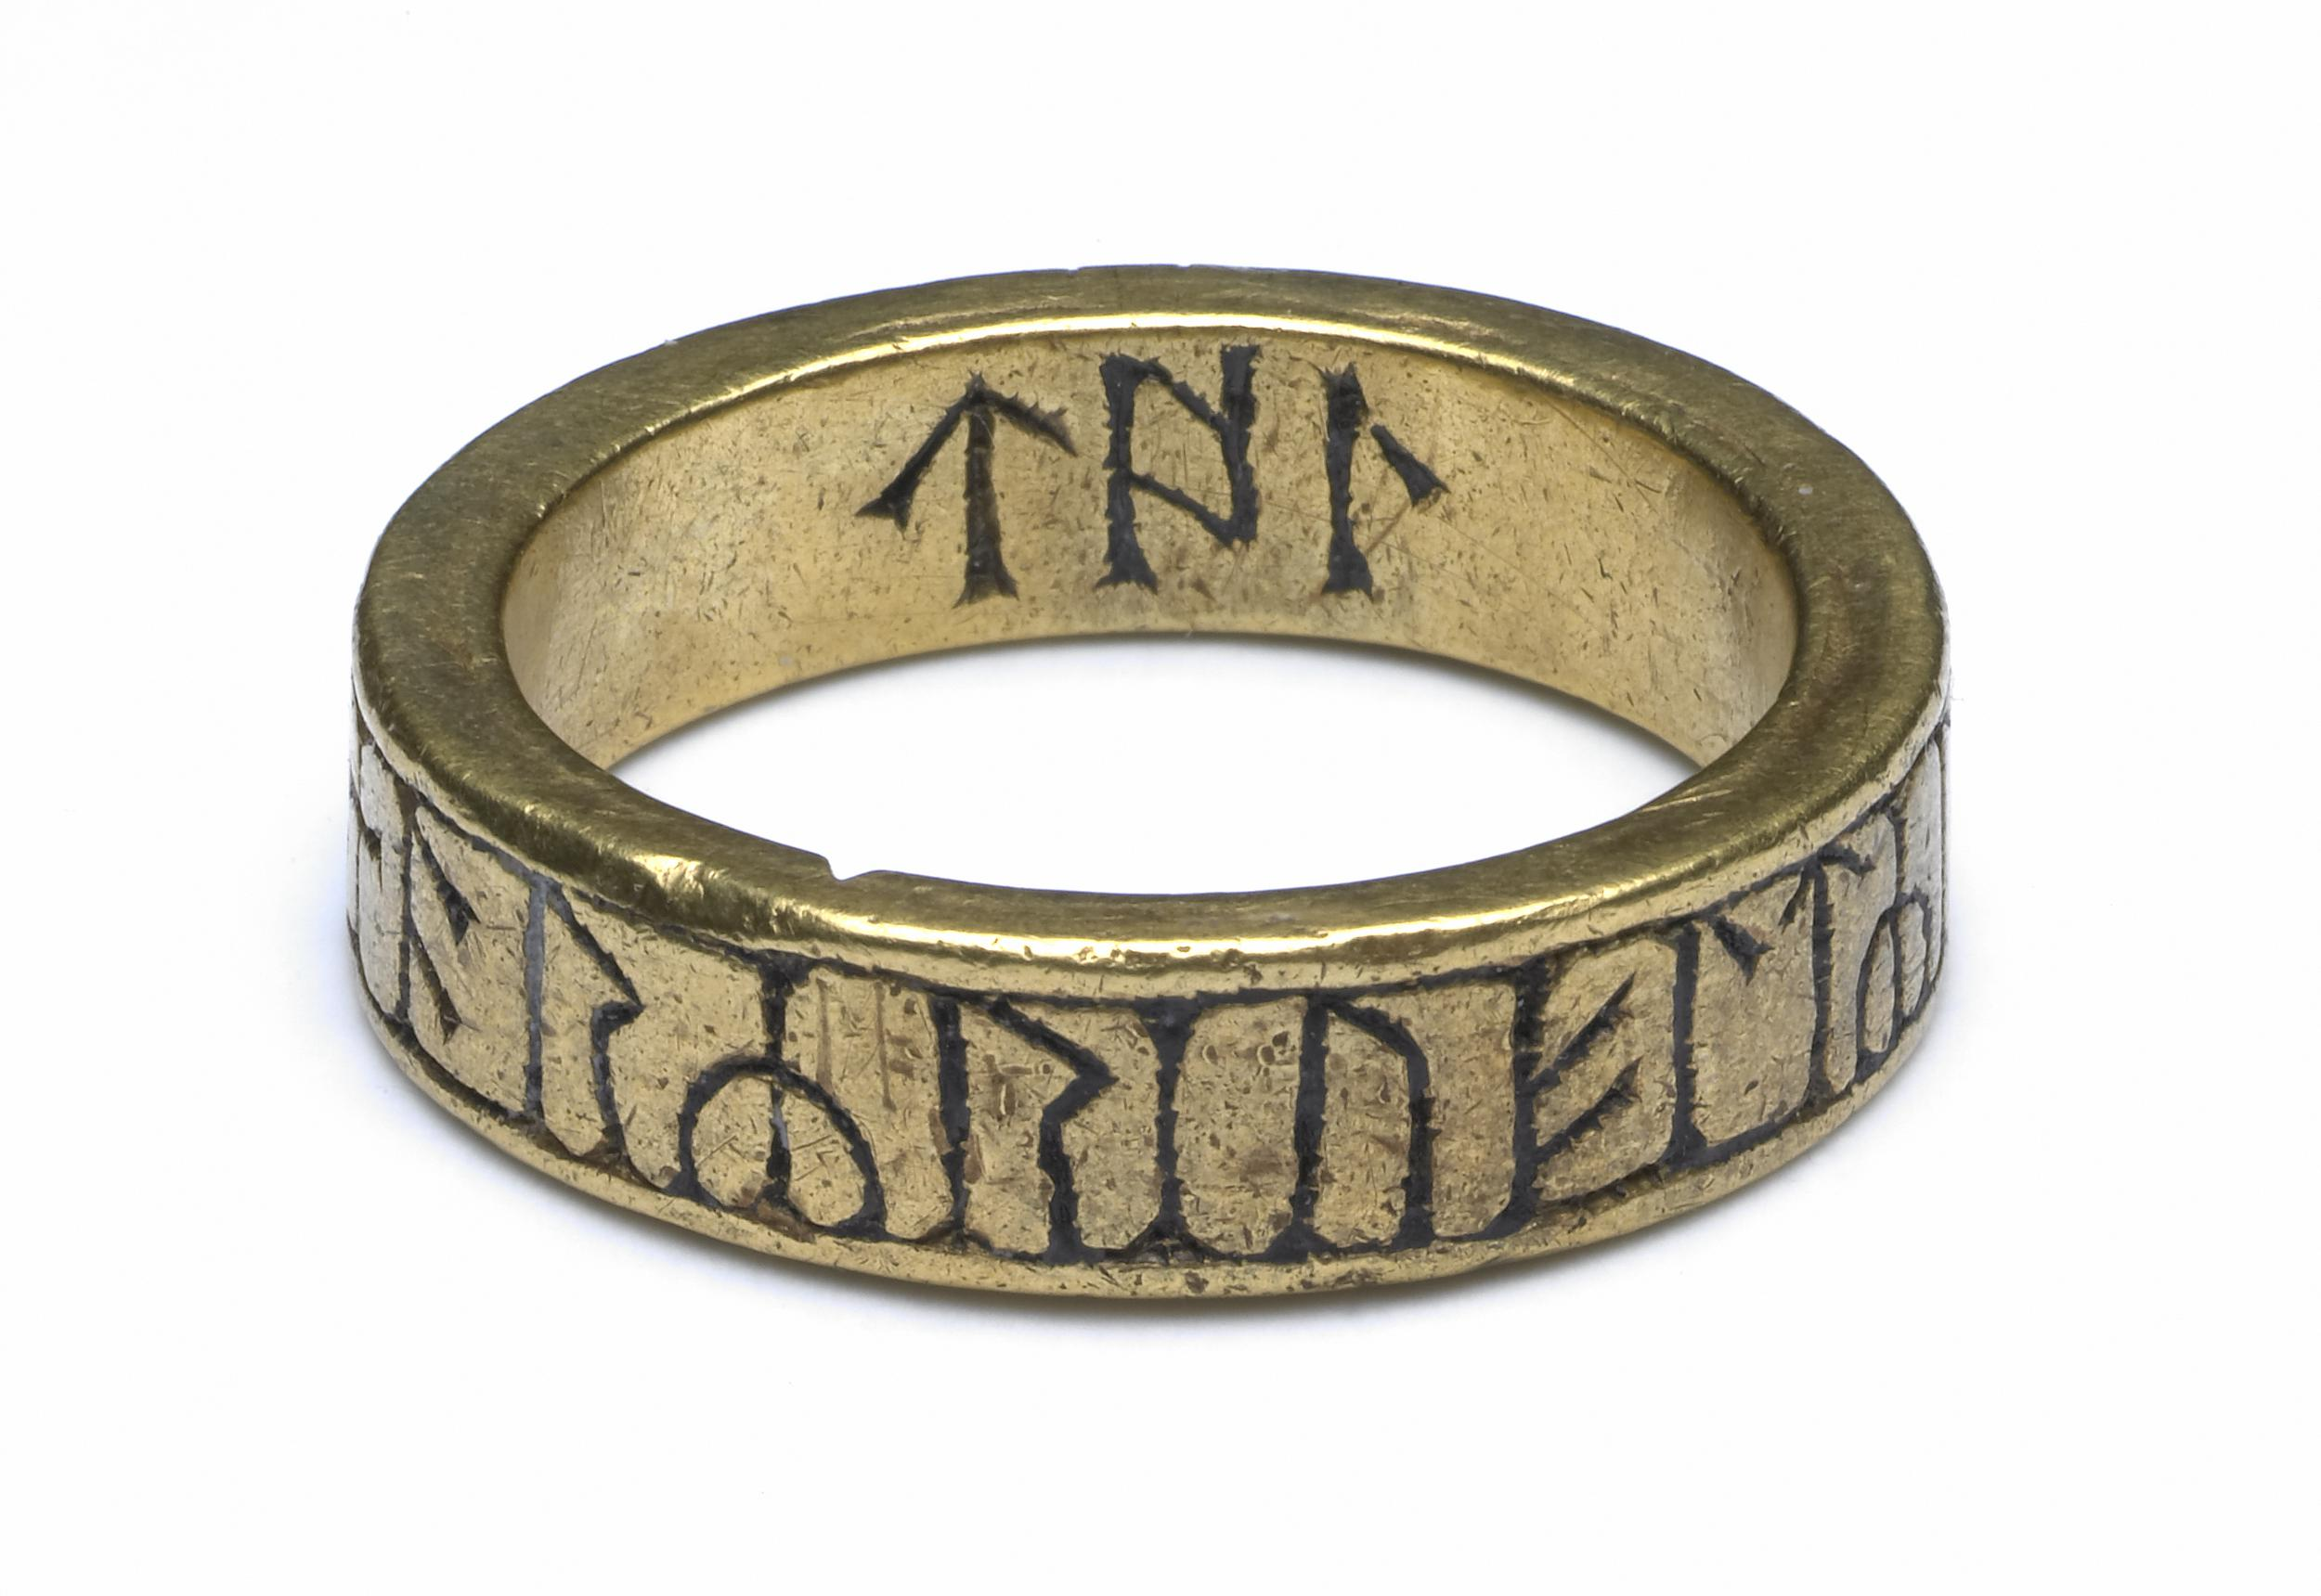
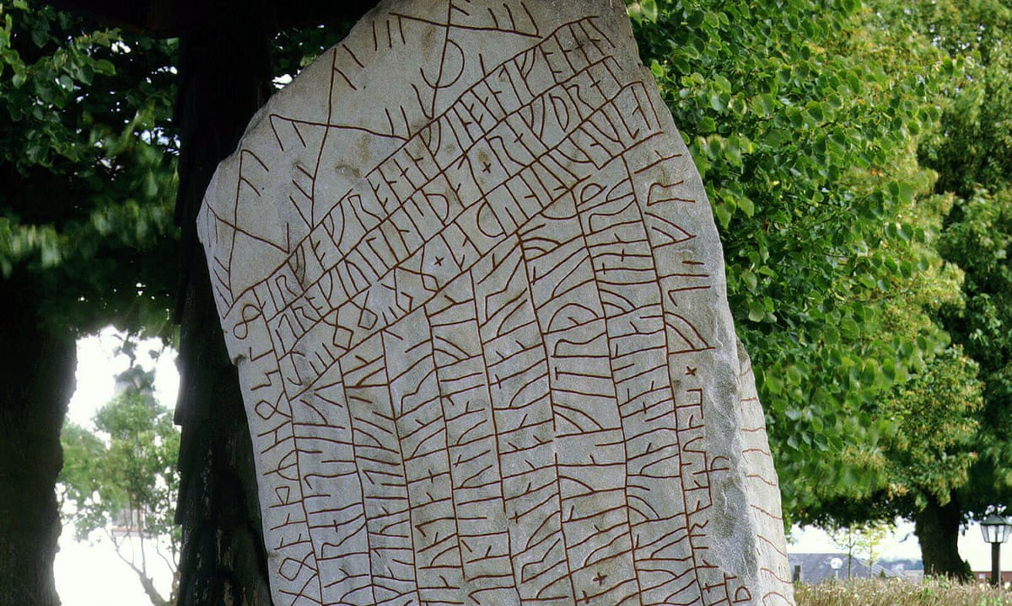
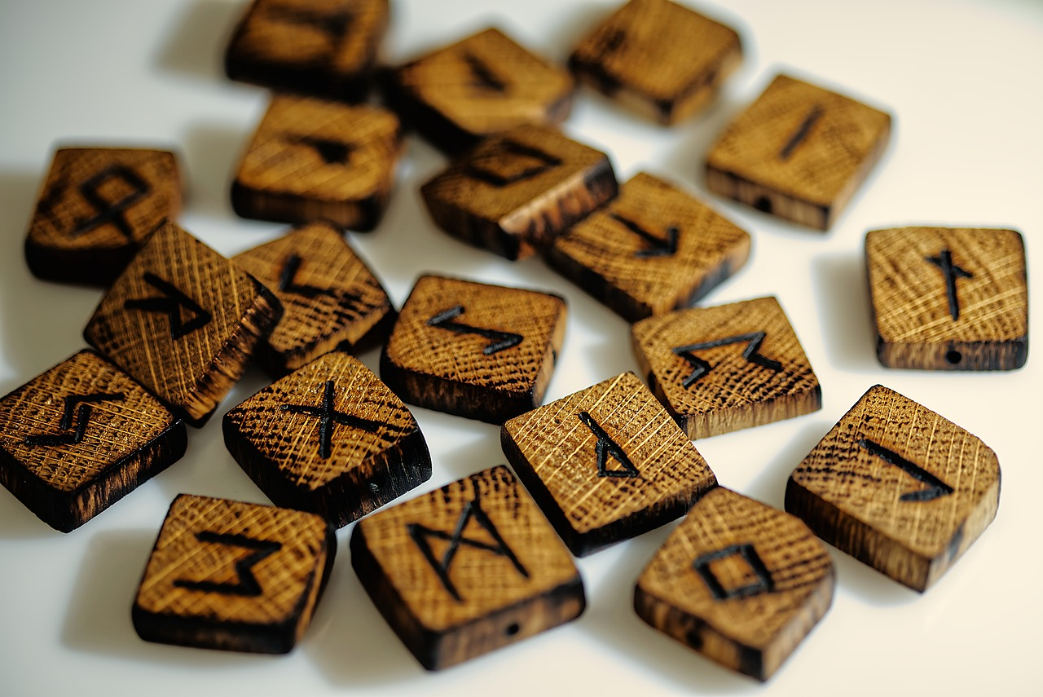
What are Runes?
Oops, sorry. Let’s try that again in English..
What are runes?
At the end of chapter 2, Freya reads some runes aloud and she and Chester are magically transported, but what are they? Here’s a clue: They look like this:
And this
And this

Slide 2
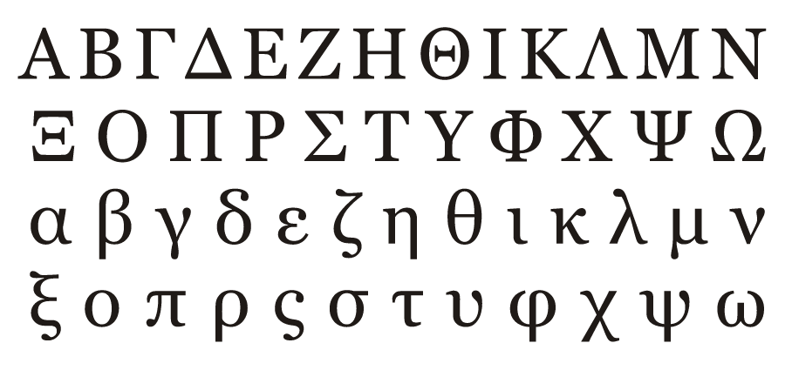
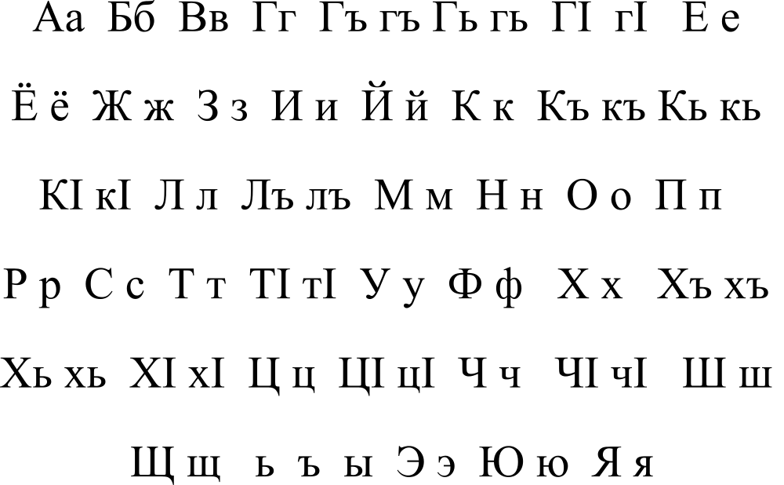
Learning Your ABCs
Quite simply, runes are just letters. Different civilisations have different alphabets, and some of them have letters that look different to ours.
Greek
The Ancient Norse futhark also looks different, although you can see the similarity in a lot of the runes to our letters.
Cyrillic

Slide 3
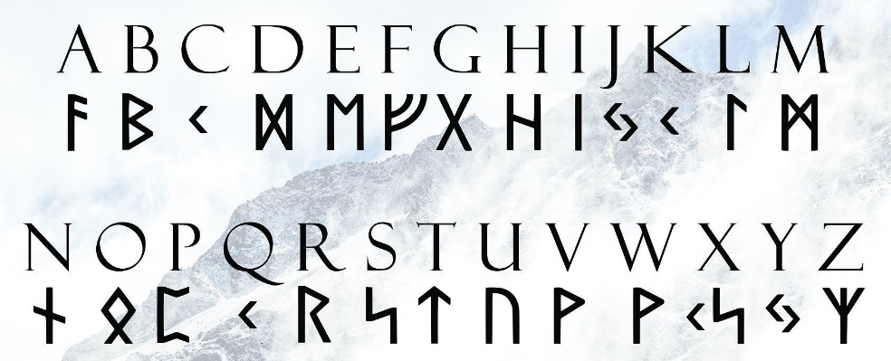
A b c d e f g h I j k l m n o p q r s t u v w x y z
A B C D E F G H I J K L M N O P Q R S T U V W X Y Z
The futhark (alphabet) was not the same everywhere and all the time. Here is one version…
Here is another.
We’re going to concentrate on that second one.

Slide 4
A few interesting things to note: C, K and Q are all the same (because they mostly make the same sound).
J and Y, and V and W are also the same, which is a bit more confusing.
X does not exist as its own rune but is simply K and S put together. Which makes sense when you think about it.

Slide 5
Fancy a go for yourself? Why don’t you try writing out your name in Ancient Norse runes?

Slide 6
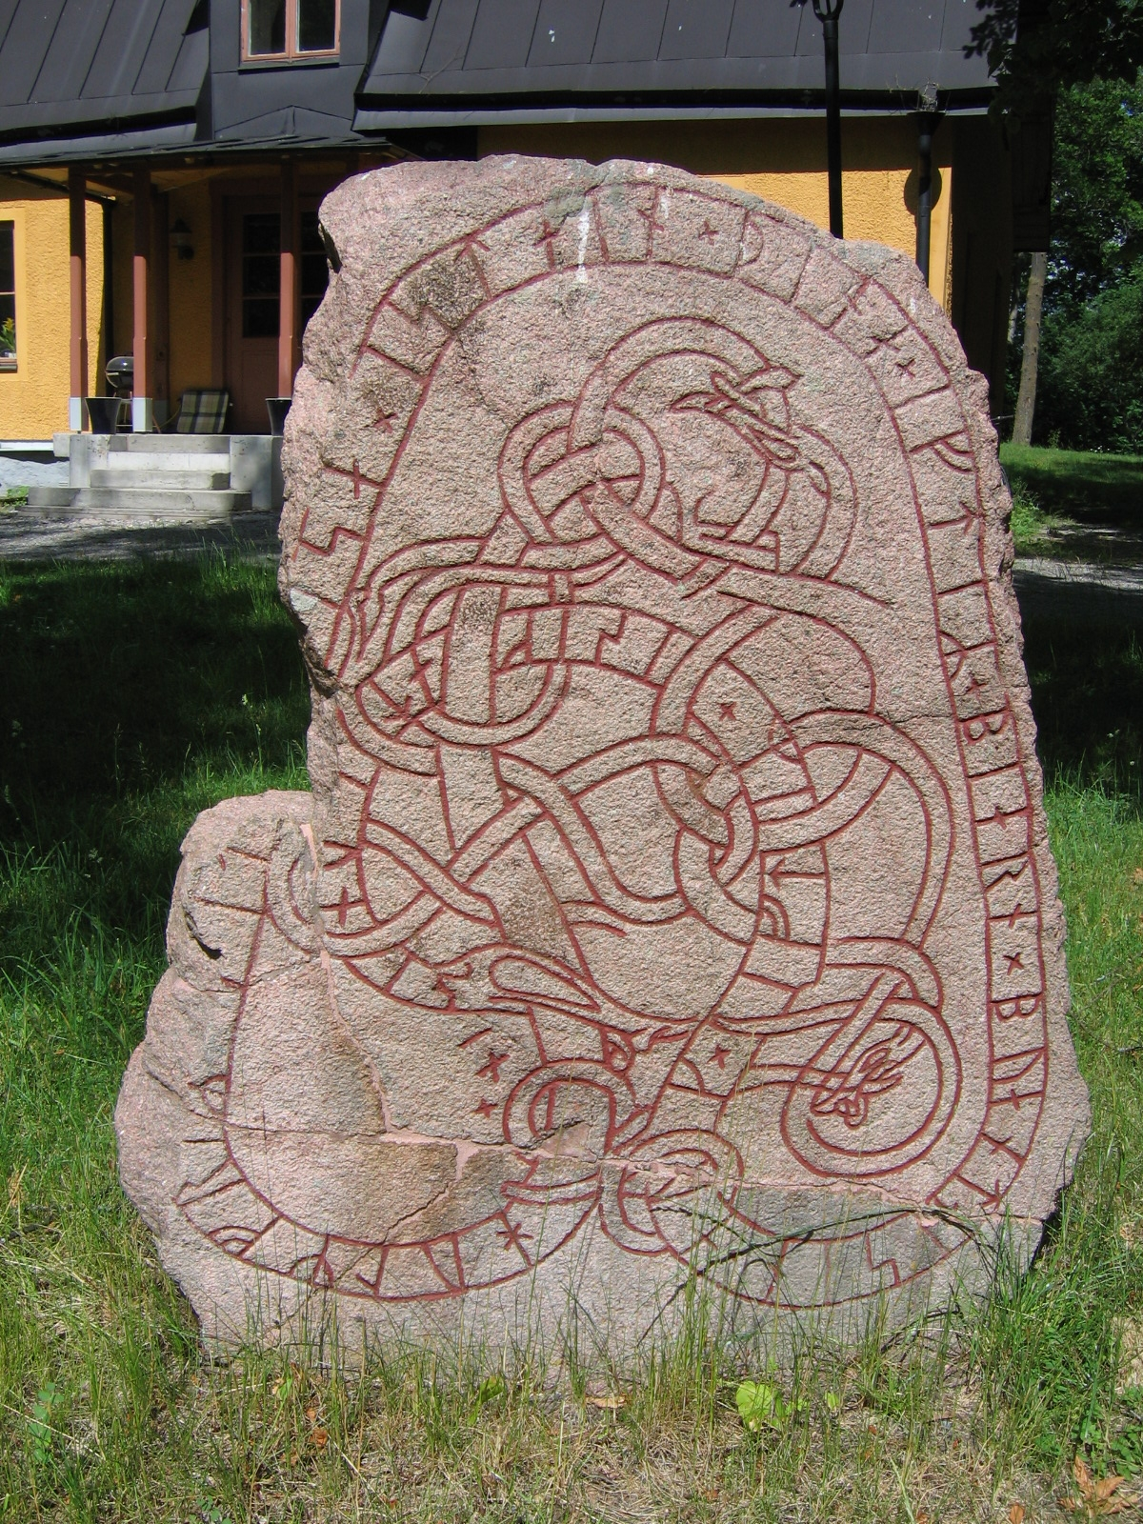
It’s Written in the Stones
It’s written in the stones
To be honest, vikings weren’t big fans of writing things in general. They didn’t really write books or even their own laws, so we mostly see Ancient Norse in two places: As graffiti (naughty vikings!) and runestones.

Slide 7
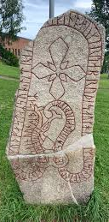
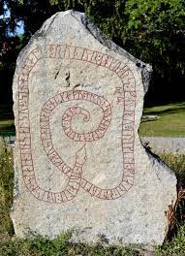
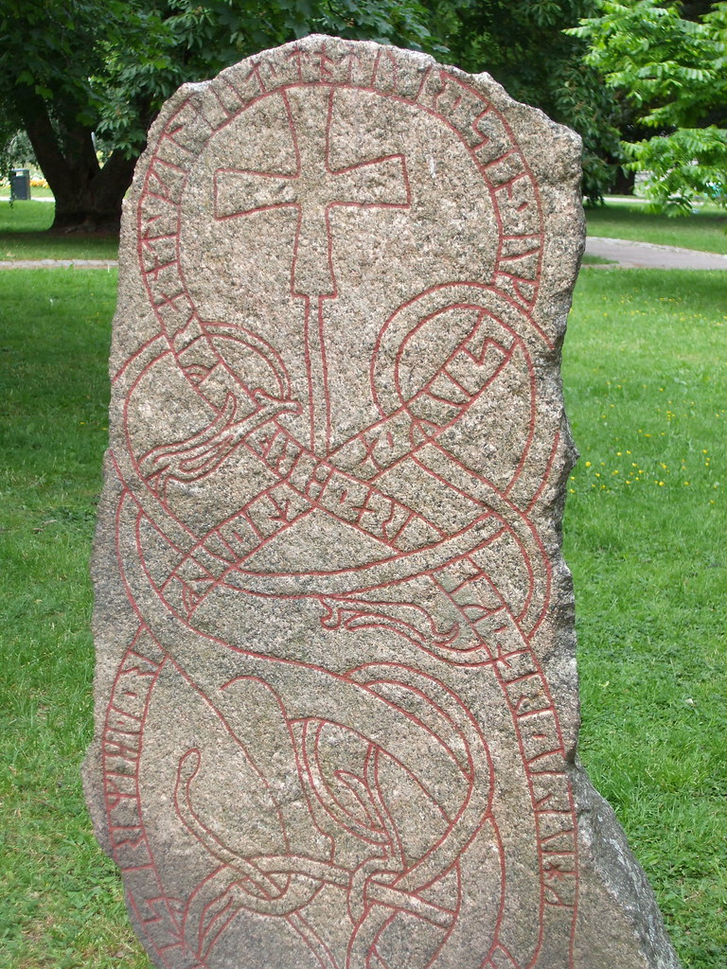
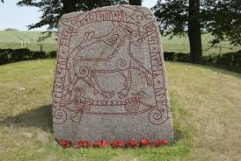
It’s Written in the Stones
It’s written in the stones

Slide 8
It’s Written in the Stones
It’s written in the stones
Runestones do what they say on the tin. They’re stones with runes on them. They usually commemorate a big event or someone who has died or a story from their religion or mythology.
They usually look pretty similar. A big grey rock, carved and painted with red. Runes telling the story in a border around the outside and a picture in the middle. Common things to depict were snakes, dragons and crosses. People, gods, boats and horses also show up quite a lot.

Slide 9
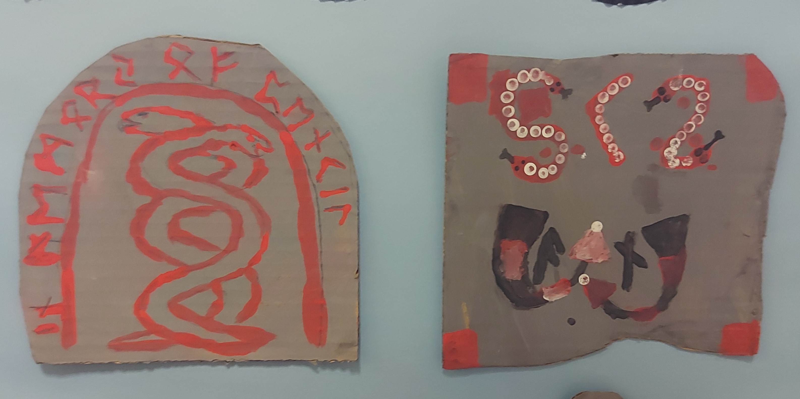
Let’s Try It!
Let’s Try It
To make your own runestone, all you need is a material, perhaps cardboard, that you can paint or colour in grey, some red paint or felt tips and a handy Norse translation guide.
What to draw and write? You could do it about yourself, a viking event you’ve learned about or even Chester and Freya’s fateful trip into the unknown.

