Slide 1
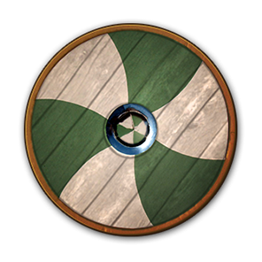
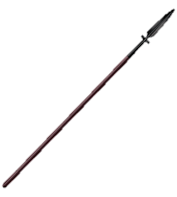
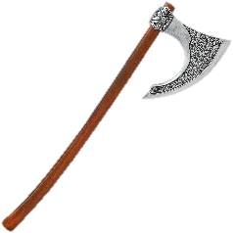
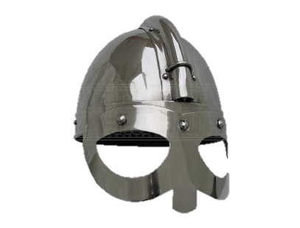
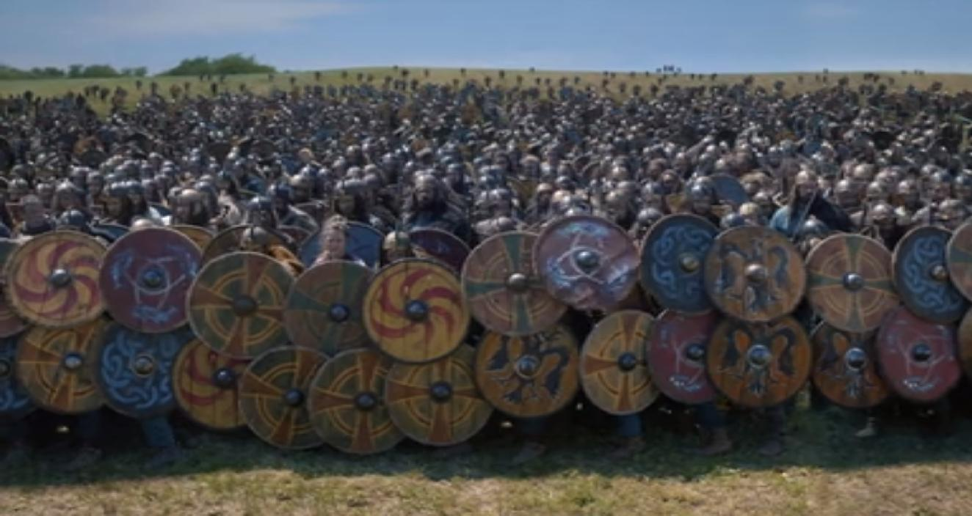
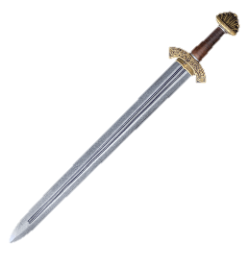
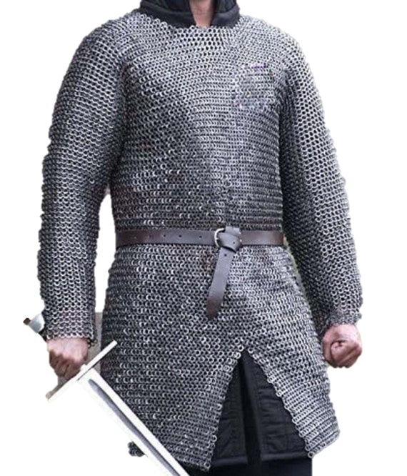
The Fight against the vikings
Vikings fought with shields and axes, spears or swords.
They fought on foot and in shield walls.
If they had it, their armour was a steel helmet and a shirt of maille.

Slide 2
The Fight against the vikings
Anglo-Saxons fought with shields and axes, spears or swords.
They fought on foot and in shield walls.
If they had it, their armour was a steel helmet and a shirt of maille.

Slide 3
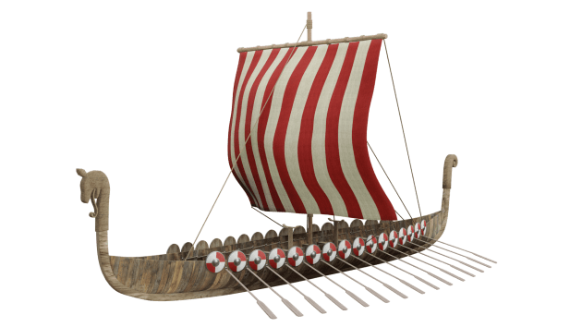
So why were the vikings winning?
Again and again, the vikings came and raided, and before King Alfred, the Anglo-Saxons could do almost nothing about it.
Why?
Their ships and the way they attacked meant that the vikings could arrive quickly and unexpectedly, and be gone before any militia or army could be raised against them.

Slide 4
The Burhs
After Alfred became the King of Wessex, he too lost many raids and battles against the vikings, even seeing his country being effectively seized for a time by the Danes. He needed an idea, and he came up with a great one.
The Burhs

Slide 5
The Burhs
The Burhs were fortified towns that Alfred built all over his lands. The idea was that, when vikings attacked, people inside the burh would be protected by its walls and the soldiers inside; People who lived nearby could flee to it; and soldiers could be based there and be sent out to attack any invaders.

Slide 6
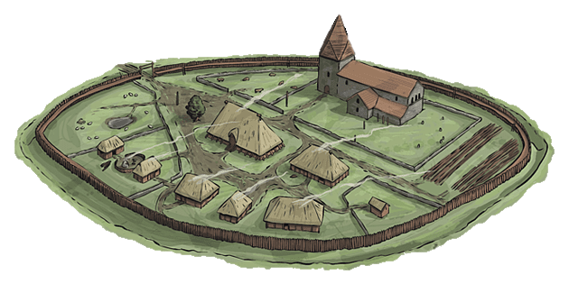
The Burhs
They varied in size, but however big they were, the burhs would need similar things. They would need protective walls (mostly made of wood), gates to let people inside. Space for soldiers to live, a church for worship, farms in and around it for food, and all the regular facilities of a medieval village.

Slide 7
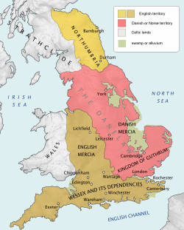
The Danelaw
The burhs and Alfred’s leadership meant that he was able to retake control of Wessex, and he eventually became so powerful that all the other English Kings submitted to him (before, England was split into different kingdoms with different kings), and he became the first King of the English.
But he wasn’t King of England. Not all of it anyway. Large swathes of the North and the Midlands were still controlled by Norse people, with their capital in York (then called Jorvik). This area of land was known as the Danelaw.

Slide 8
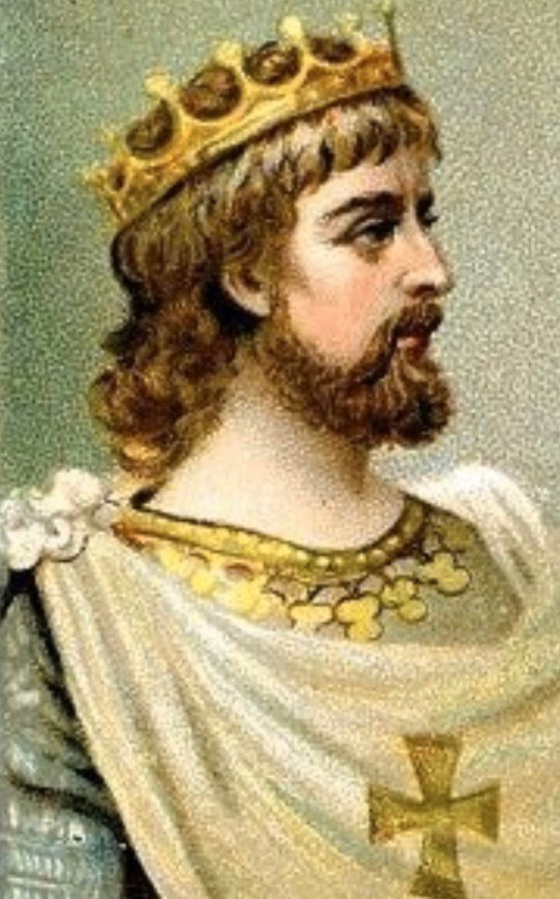
The Danelaw
The job of taking back the rest of the country from the vikings went to Alfred’s children and grandchildren, some of whom we will meet now.
The first true King of England was Alfred’s grandson Aethelstan, who united the country in 927 by conquering York.

Slide 9
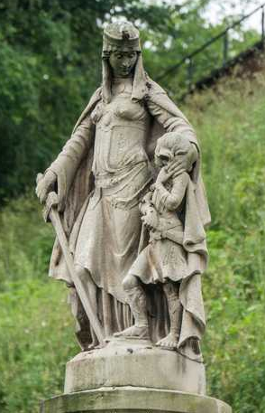
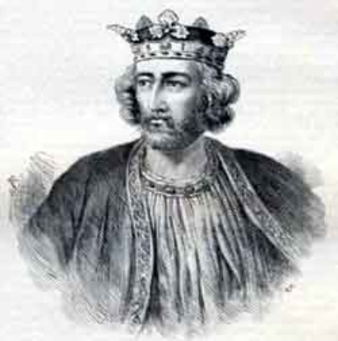
Alfred Junior
Alfred the Great had four children, and two of them would play a major role in ridding England of the Vikings once and for all.
Edward took over from his dad as King of Wessex and King of the English. Aethelflaed married the King of Mercia, and was later chosen to rule Mercia herself.
Edward the elder
Aethelflaed

Slide 10
An elected queen
The Anglo-Saxons didn’t just have the eldest son of the King become king after him. The council (or Witan) decided voted on who would be king, although they had to choose someone who had ‘royal blood’.
After her husband, the King of Mercia, died the Witan chose to elect Aethelflaed to be their leader, and she became one of the first ruling European women. They didn’t even have a word for female king (queen just meant wife of the king), so they called her ‘Lady of the Mercians’
Her statue shows her with her arm around her nephew Aethelstan, the first King of England, who she helped raise.

Slide 11
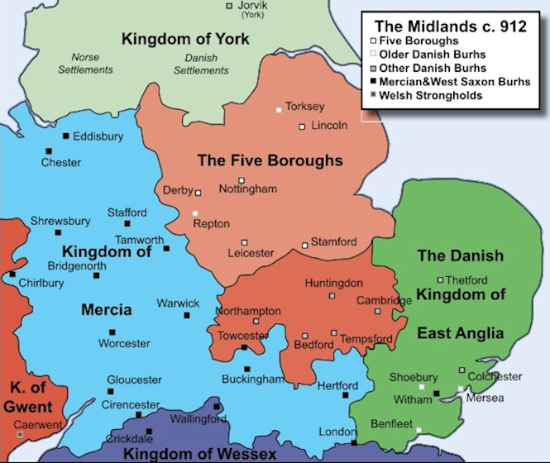
Tag Team
Edward the Elder was King of the English, meaning that he was Aethelflaed’s Overking, but they worked together as a team to rid the country of the vikings once and for all. First, they carried on their father’s work of building burhs all over the country, then they took the fight to the vikings.
Much of Mercia was controlled by the Danes, so with her brother’s support, Aethelflaed commanded her armies as they took back the Five Boroughs of the Danelaw. One by one, Derby, Leicester, Lincoln, Nottingham and Stamford were either conquered or surrendered. Sadly, Aethelflaed died just before Mercia was fully taken back, and her brother Edward was left to finish the job.

Slide 12
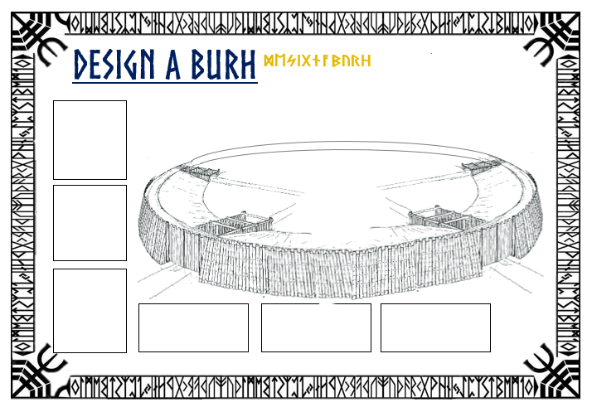
Task
Design a Burh
Think about what buildings and resources you will need.
Draw and label the different buildings and defences, and add details for some such as what they are for and what they are made of.

